Slide 1
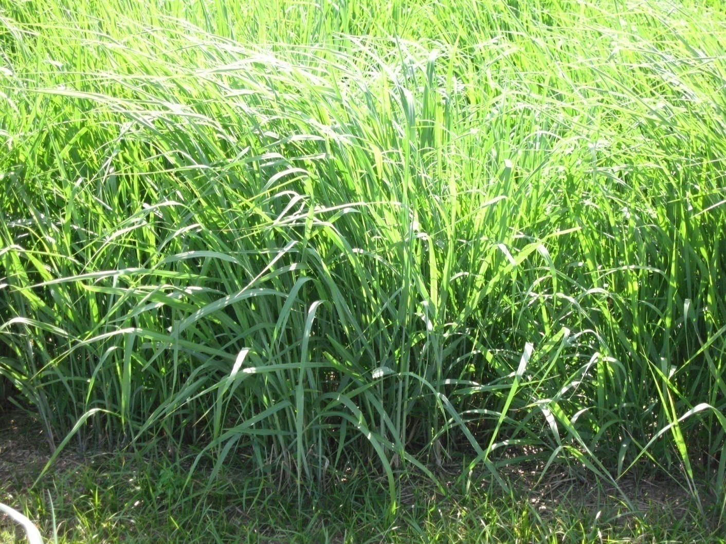
module #6
Forage Management
Pine Silvopasture in the Southeast

Slide 2
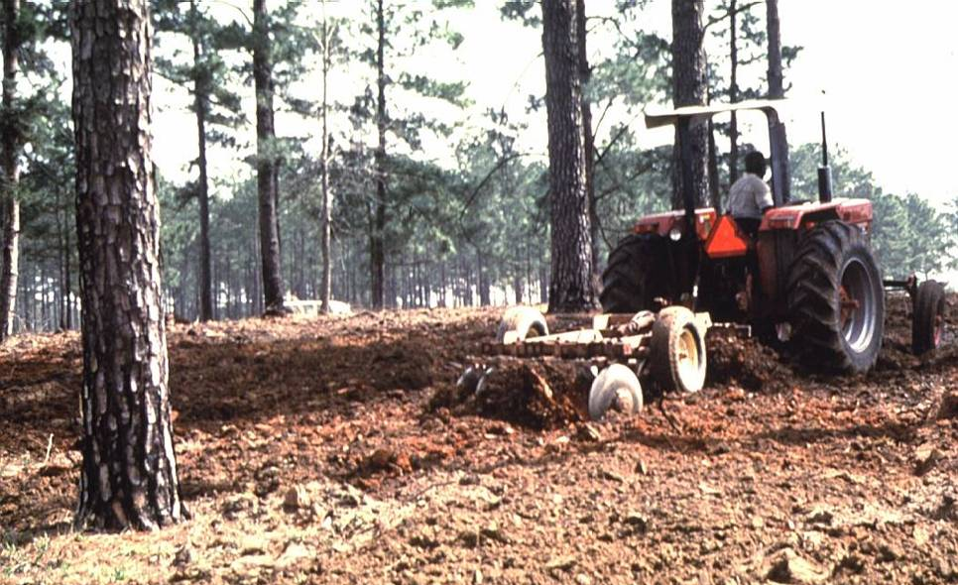
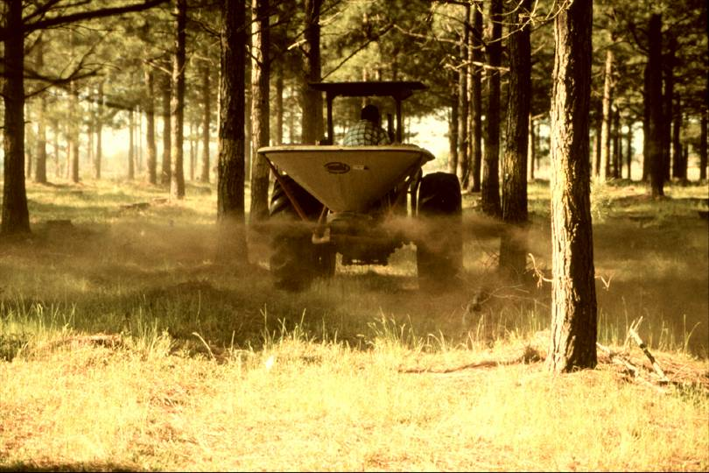
Forage Establishment
Establishing additional forage may be required to provide balanced nutrition for livestock in a silvopasture.
Forage establishment in a silvopasture is not very different from accepted open pasture practices. Site preparation and seeding are the same.
However, fertilizers and soil amendments must also account for the tree component.
Select forage species that can tolerate the low soil pH that pines favor
{Lecture 6b} Slide: 2/10

Slide 3
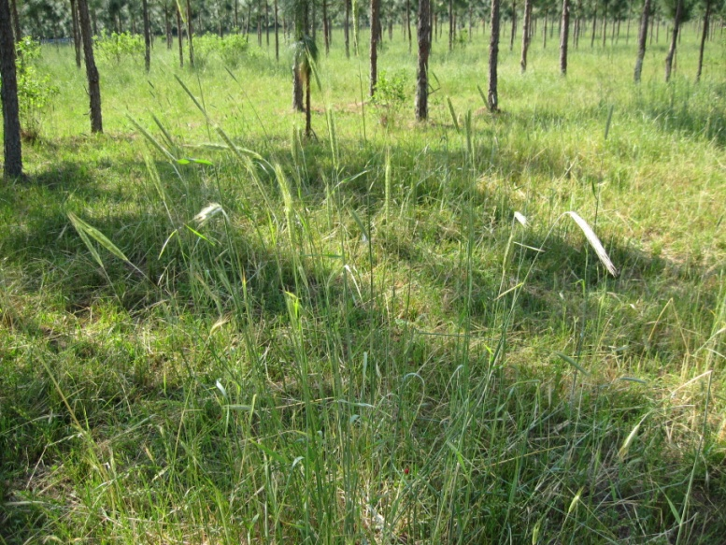
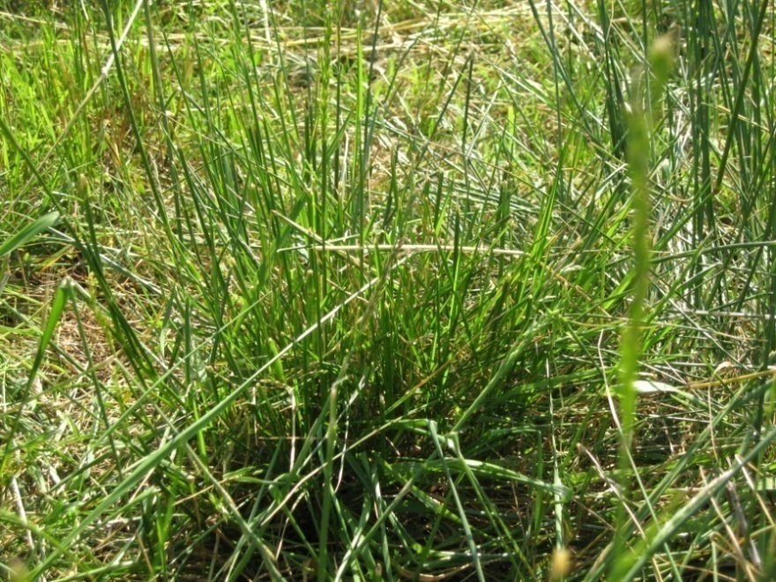
Seasonal Acreage Allocation
Forage systems that incorporate cool and warm season grasses can provide almost year-round nutrition for cattle.
A general guide for warm season vs. cool season grasses is to plant around 1 acre of warm season grasses for every 2 and ½ to 3 acres
of cool season grasses.
{Lecture 6b} Slide: 3/10

Slide 4
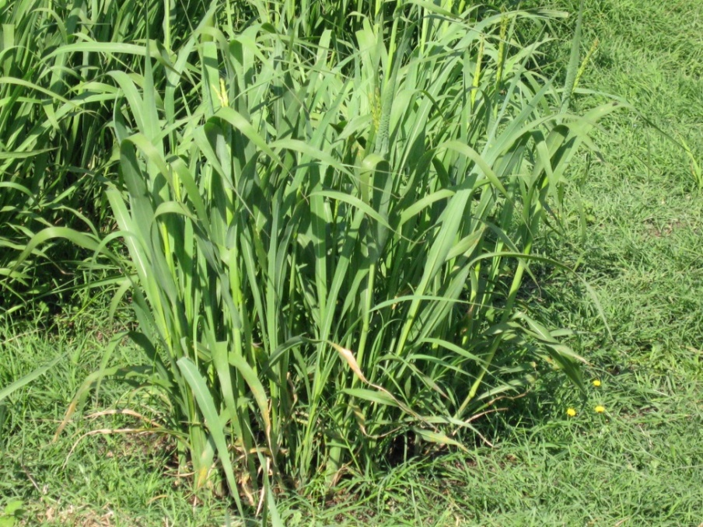
Forage Growth Seasons
BE FAMILIAR WITH THE GROWTH PERIOD OF YOUR FORAGE
In general, cool season forages produce most growth in spring, while warm season forage
growth occurs between April
and October.
Forage growth is very dependent on species: some produce growth very quickly and taper off while some begin growth later in season and extend further into early fall.
{Lecture 6b} Slide: 4/10

Slide 5
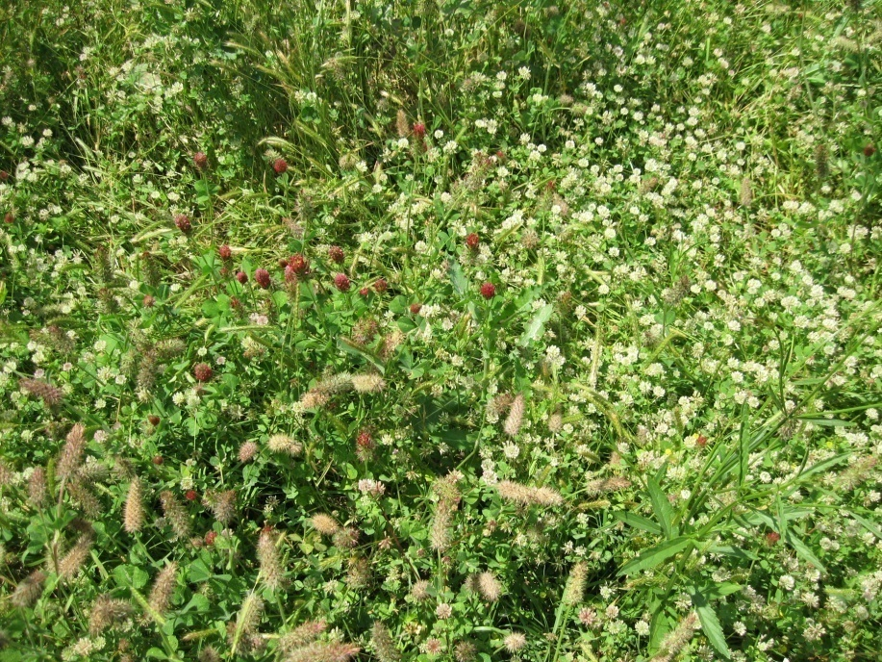
Forage Regrowth Initiation
After forages have been grazed down, regrowth initiation takes place within
3 to 7 days.
The last cutting or grazing of forage/pasture should allow enough regrowth before a killing frost to allow plants to store enough carbohydrates for the following year.
Low-growing forage like bermudagrass and white clover can typically withstand late-season grazing due to carbohydrate reserves in roots and stems.
{Lecture 6b} Slide: 5/10

Slide 6
Forage Regrowth Initiation
Continuous selective grazing weakens desirable forage species creating weedy pastures and areas of overgrazing and under grazing.
This creates high impact areas that can have detrimental impacts on tree growth and survival.
High impact area with exposed tree roots
{Lecture 6b} Slide: 6/10

Slide 7
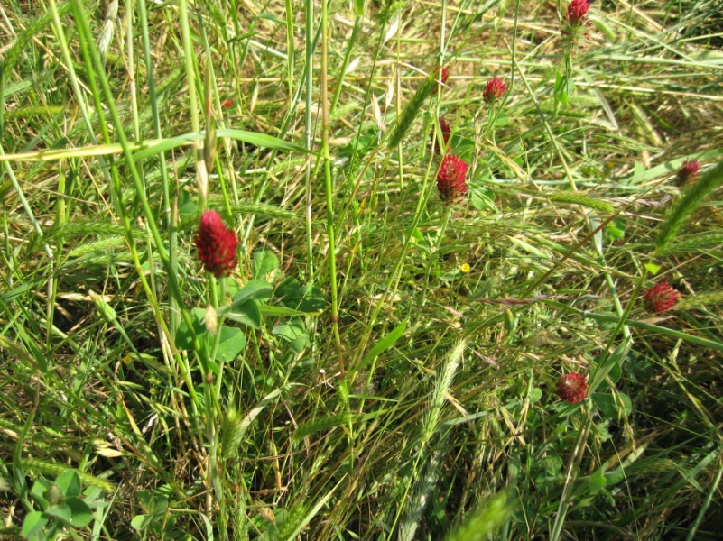
Role of Rotational Grazing
A Rotational Grazing Plan MUST be followed to ensure adequate forage recuperation and production to meet livestock nutritional needs.
While there are various formulas to determine the number of grazing units or pasture areas to establish, most systems have 8 to 10 pastures.
Rotational grazing is covered
in more detail in livestock management module.
{Lecture 6b} Slide: 7/10

Slide 8
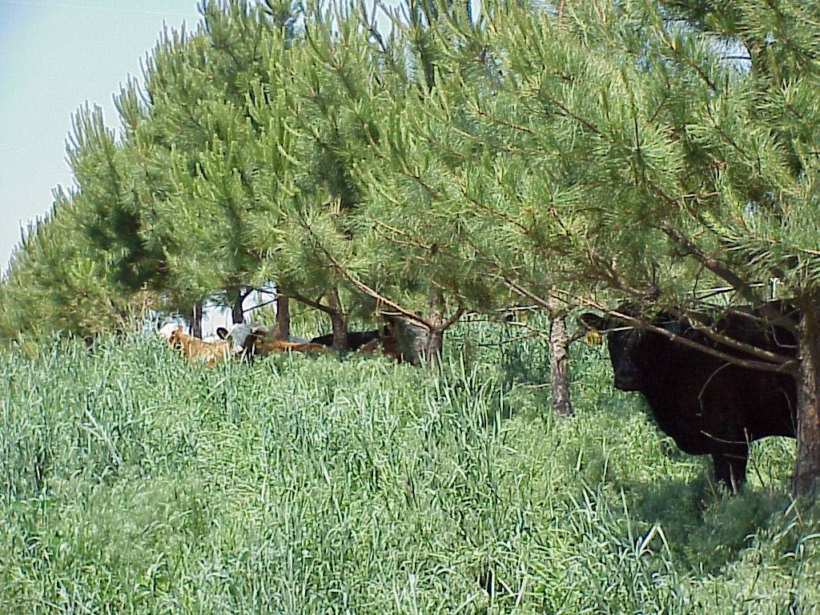
Forage and herbicides
Care must be taken for herbicide applications for both tree seedling and forage components in a silvopasture.
Newly planted tree seedlings are more susceptible to herbicide drift
{Lecture 6b} Slide: 8/10

Slide 9
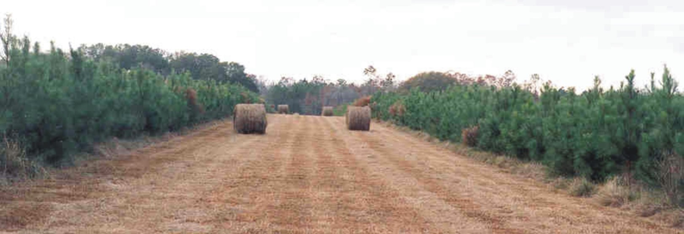
Hay Production
Livestock should not be introduced into a silvopasture until the top branches of trees have grown out of their reach
Until trees are established, alleyways between tree row sets can be managed for hay production
{Lecture 6b} Slide: 9/10

Slide 10
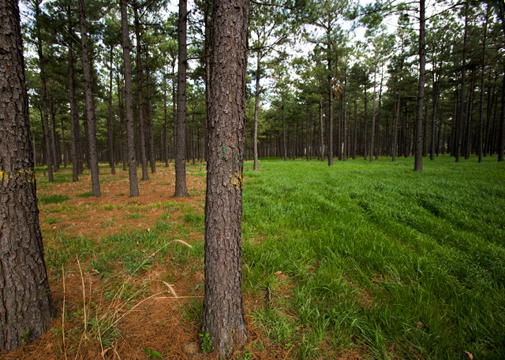
Summary
Proper forage management is essential for a healthy and productive silvopasture.
Following a rigorous rotational grazing schedule and monitoring forage regrowth will ensure that nutritional quality of forage is sustainable for livestock.
The left part of this pine stand is unfertilized, unplanted, and covered with pine straw. The right side is planted with fertilized ryegrass.
Photo by Stephen Ausmus.
{Lecture 6b} Slide: 10/10

