Slide 1
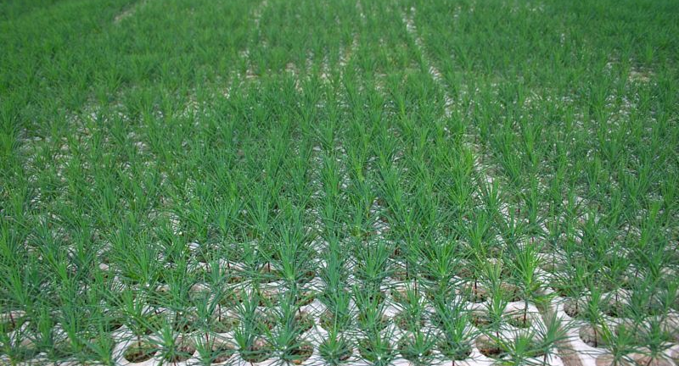
module #3
Seedling Considerations
Pine Silvopasture in the Southeast

Slide 2
Seedling Considerations
By the end of this microlecture you should be able to:
Understand the importance of genetically improved seedlings
Understand the importance of good root structure in seedlings
Discuss the advantages and disadvantages of bare root and containerized seedlings
{Lecture 3b} Slide: 2/13

Slide 3
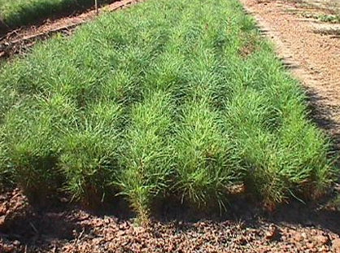
Seedling Considerations
Besides choosing the particular species to be planted within a silvopasture system, there are additional considerations that need to be made regarding the type of seedlings to outplant.
Commercial seedlings are grown by a number of methods—each of which has its own advantages and disadvantages.
{Lecture 3b} Slide: 3/13

Slide 4
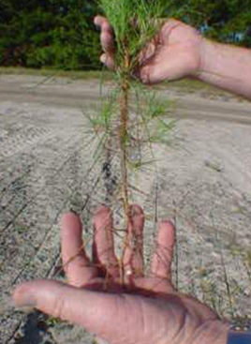
Root Development
Larger diameter seedlings with many fibrous roots are considered ideal. Well-developed, fibrous root systems can establish themselves more quickly in the soil to extract nutrients and water.
Seedlings that produce many new roots within four weeks of planting will survive better than seedlings that produce only a few new roots after outplanting.
{Lecture 3b} Slide: 4/13

Slide 5
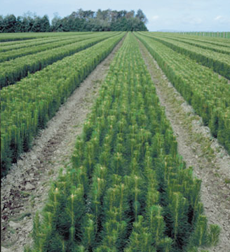
Genetically Improved Seedlings
Genetically improved tree seedlings are preferred for silvopasture establishment.
Improved seedlings are cultivated from seeds from selected trees that have been carefully chosen due to their superior genetic characteristics: height, growth rate, disease resistance, and form.
Ask the nursery where you’re purchasing seedlings if seedlings are genetically improved.
{Lecture 3b} Slide: 5/13

Slide 6
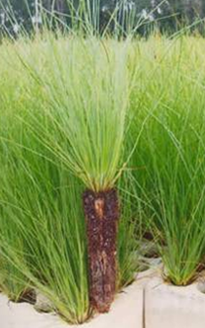
Containerized Seedlings
Containerized Seedlings are grown in a greenhouse in plastic or styrofoam tubes, rather than in a nursery bed. The root systems of containerized seedlings are well developed.
Containerized seedlings are more expensive than bareroot seedlings but often have better survival rates and intact root structure for outplanting.
{Lecture 3b} Slide: 6/13

Slide 7
Advantages and Disadvantages of Containerized
Advantages:
Disadvantages:
Roots not as easily damaged as bare-root when removed from planting medium
Easier to plant
Extended planting season. Either during the winter or after summer rains begin.
Generally more expensive.
Not readily available at some nurseries.
Smaller size makes seedlings difficult to establish with heavy competition.
Requires good site preparation of the planting site and follow-up management to reduce competition.
{Lecture 3b} Slide: 7/13

Slide 8
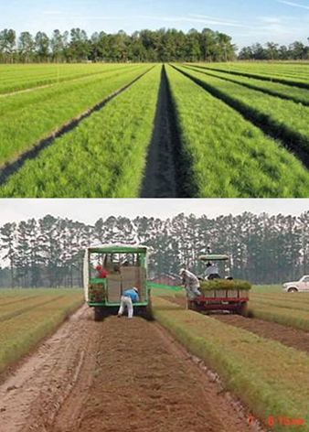
Bareroot Seedlings
Bareroot Seedlings are grown in a nursery bed and extracted mechanically for packaging for sale.
Bareroot seedlings must be kept cool and moist until planting as their roots are exposed after being extracted from the nursery bed.
{Lecture 3b} Slide: 8/13

Slide 9
Advantages and Disadvantages of Bareroot
Advantages:
Disadvantages:
Have larger root systems that provide greater rooting depth and less susceptibility to frost-heaving.
Better suited to planting sites with higher levels of competition due to larger size.
Generally less expensive than container stock.
More difficult to plant than container stock due to size
Root placement is critical as bareroot seedlings have longer root systems
Have to be planted during the winter
{Lecture 3b} Slide: 9/13

Slide 10
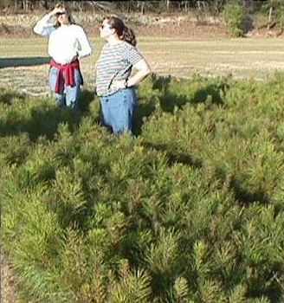
Low Density Seedlings (Bareroot)
Low Density Seedlings are grown at lower density (around 18 seedlings per square foot) than traditional nursery beds.
Large seedlings grown at low density in a nursery have much more desirable root characteristics than smaller diameter seedlings grown in crowded nursery beds.
These seedlings are more expensive than traditional bareroot seedlings.
http://www.sfws.auburn.edu/sfnmc/class/fy614/fullsib.jpg
{Lecture 3b} Slide: 10/13

Slide 11
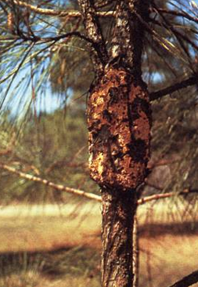
Fusiform Rust Resistance
It is especially important to use fusiform rust resistant seedlings if slash or loblolly pines are planted.
Fusiform rust is an infectious fungus that causes spindle-shaped swellings or galls that develop on the branches or main stem. Infections that occur on the main stem within the first 5 years of a tree's life normally cause tree death.
http://fhpr8.srs.fs.fed.us/forstpst.html
http://www.barkbeetles.org/spb/IPMinSPF/fig4b.jpg
{Lecture 3b} Slide: 11/13

Slide 12
State Contacts for Seedlings
Alabama Forestry Commission
513 Madison Avenue
Montgomery, AL 36104
(334) 240.9300
Florida Division of Forestry 3125 Conner Boulevard
Tallahassee, FL 32399-1650
(850) 488-6591
Georgia Forestry Commission
5645 Riggins Mill Road
Dry Branch, GA 31020
1-800-GATREES
Mississippi Forestry Commission
301 N Lamar, Suite 300
Jackson, MS 39201
(601) 359-1386
Louisiana Department of Ag and Forestry
Forestry, Suite 1068 P.O. Box 1628 Baton Rouge, LA70821
(225) 925-4500
Tennessee Division of Forestry
Ellington Agricultural Center Box 40627, Melrose Station Nashville, TN 37204
(615) 837-5520
North Carolina Division of Forest Resources 1616 Mail Service Center Raleigh, NC 27699-1616
(919) 733-2162
South Carolina Forestry Commission 5500 Broad River Road Columbia, SC 29212 (803) 896-8800
{Lecture 3b} Slide: 12/13

Slide 13
Summary
Genetically improved seedlings can produce superior trees when planted correctly
There are advantages and disadvantages with both containerized and bare-root seedlings
Good root structure is a key factor in seedling survival and proper growth
State Forestry organizations can provide additional information about seedling availability and quality
{Lecture 3b} Slide: 13/13

