Slide 1
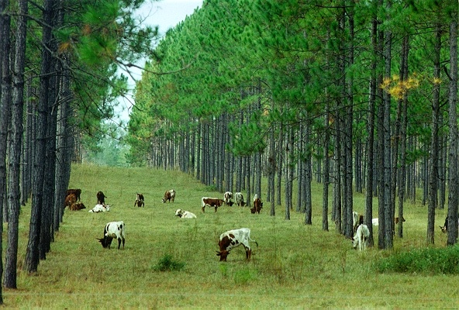
module #1
A Snapshot of Silvopasture
Pine Silvopasture in the Southeast

Slide 2
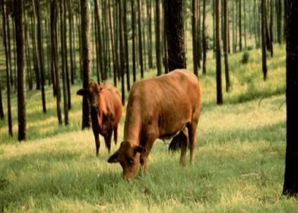
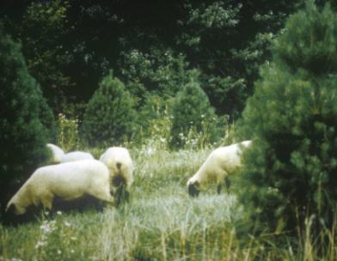
A Snapshot of Silvopasture
Definition: Silvopasture is “The intentional integration of intensive livestock management and timber production on a common plot.”
By managing forage, trees, and livestock component on the same land unit, short and long term economic benefits can be realized.
{Lecture 1a} Slide: 2/11

Slide 3
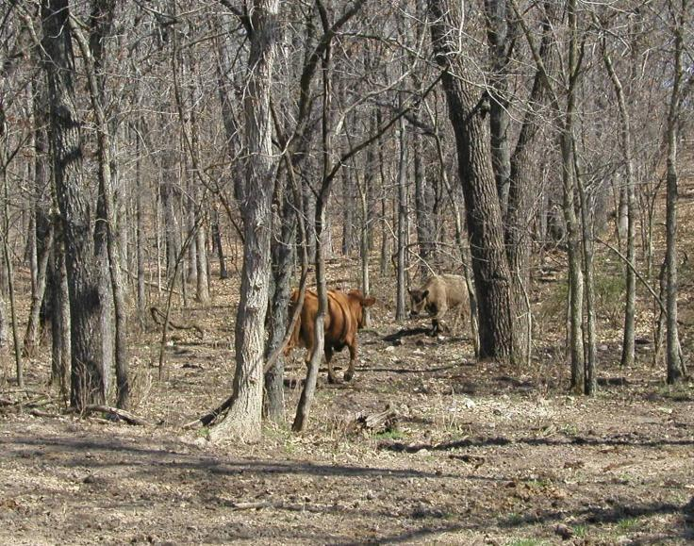
A Snapshot of Silvopasture
Cows grazing in unmanaged woodlots is not considered silvopasture
{Lecture 1a} Slide: 3/11

Slide 4
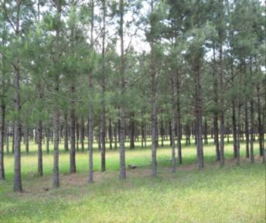
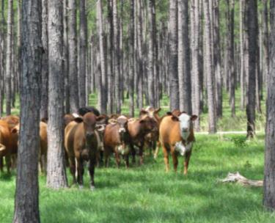
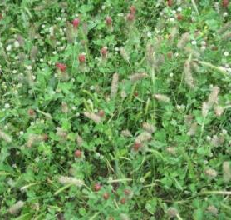
A Snapshot of Silvopasture
The three major components managed in a silvopasture system are:
Trees
Livestock
Forage
{Lecture 1a} Slide: 4/11

Slide 5
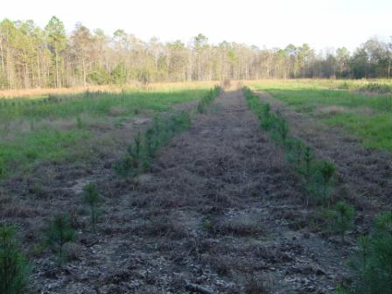
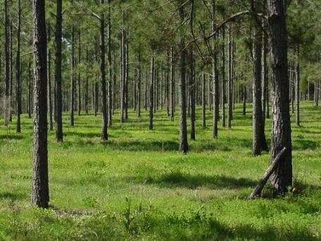
The Tree Component
A silvopasture can be initiated by planting trees into an open pasture…
Or by thinning an existing pine plantation to:
create alleyways for forage production or,
create sufficient canopy gaps to initiate quality forage growth
{Lecture 1a} Slide: 5/11

Slide 6
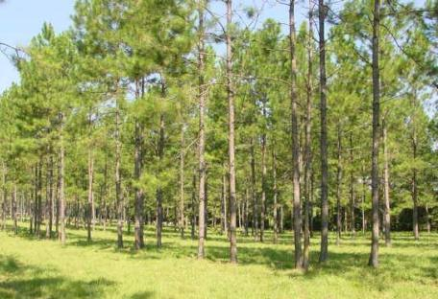
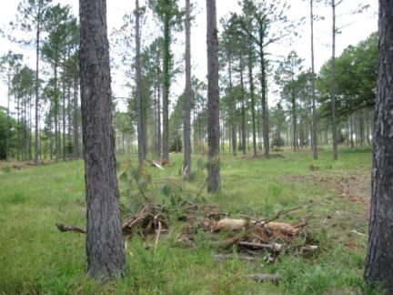
The Tree Component
Trees in a pine silvopasture system are grown in much lower densities than traditional forestry plantations--starting with around 300-400 trees per acre and periodically thinned to around 50-150 trees for final harvest.
{Lecture 1a} Slide: 6/11

Slide 7
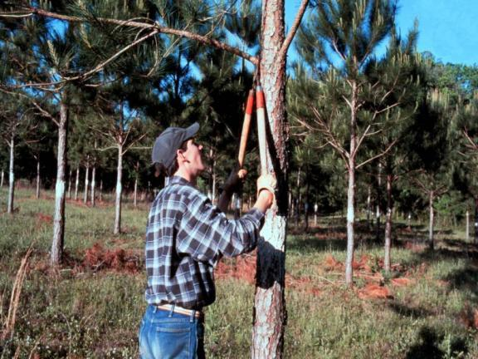
The Tree Component
Trees must be pruned periodically to remove lateral branches that can affect eventual wood quality. Pruning also increases available light for forage production.
{Lecture 1a} Slide: 7/11

Slide 8
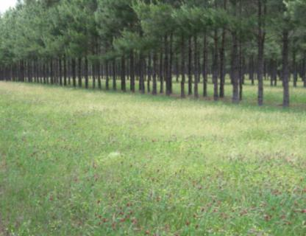
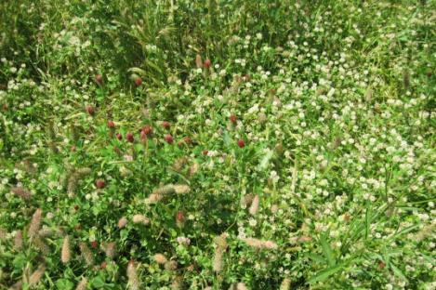
The Forage Component
Proper forage management is essential. Producers must manage appropriate cool and warm season grasses to ensure that livestock receive proper nutrition for year-round grazing.
{Lecture 1a} Slide: 8/11

Slide 9
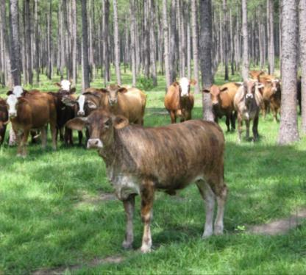
The Livestock Component
In a silvopasture system, livestock are managed for annual or short-term income. Shade from managed trees and good forage management make for healthier livestock.
{Lecture 1a} Slide: 9/11

Slide 10
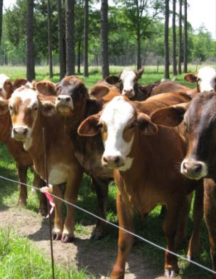
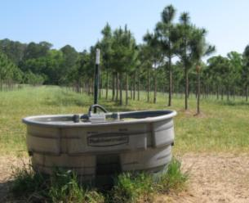
The Livestock Component
Producers can either use a continuous stocking system or rotational grazing to allow forage areas to recuperate and maximize the efficiency of their grazing operations.
Fenced “paddocks” with strategically placed water sources are important considerations.
{Lecture 1a} Slide: 10/11

Slide 11
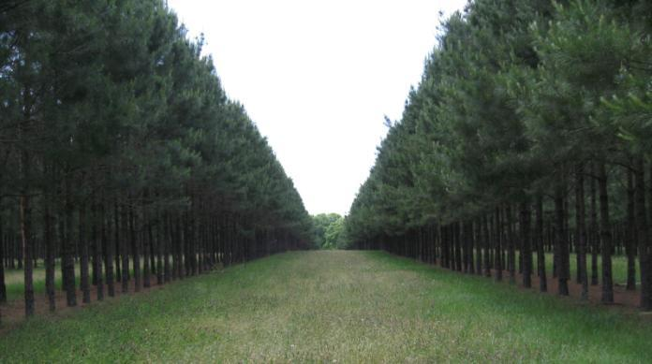
Summary
A well-managed silvopasture system can also:
Diversify farm outputs
Increase tree and forage growth
Improve overall cattle performance
Enhance property aesthetics
Increase wildlife habitat
{Lecture 1a} Slide: 11/11

