Slide 1
module #1
Economic Considerations
Pine Silvopasture in the Southeast

Slide 2
Why silvopasture?
Economic analyses have shown that intensively managed silvopasture systems can be more profitable than traditional plantation forestry and grazing systems.
Livestock production, which benefits from shade-grazing and managed forage, serves as an annual income source while timber is produced and managed for a high quality product for long term income.
Grazing may also be a way to reduce fuel loads, keeping fire risk low, and eliminate the need for chemical or mechanical competition control
{Lecture 1b} Slide: 2/11

Slide 3
Internal Rate of Return of Silvopasture Comparison
Silvopasture
Plantation Forestry
Coastal Pasture
{Lecture 1b} Slide: 3/11

Slide 4
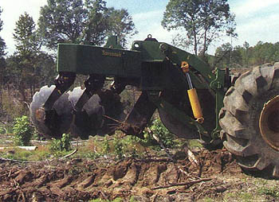
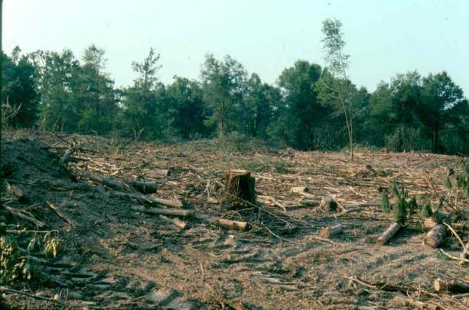
Economic Considerations
Proper Silvopasture establishment requires several initial and long-term cost considerations.
Site preparation prior to planting tree seedlings as well as annual management costs are required for a successful silvopasture system. Each component of silvopasture (trees, forage, and livestock) has its own associated costs and benefits.
{Lecture 1b} Slide: 4/11

Slide 5
Establishment Costs
Initial establishment costs may include:
Herbicides and/or Labor for removal of competition and weed management = $50 to $250 per acre depending on mechanical or chemical application used and condition of site
Prescribed burning = $20-25 per acre
Tractor/equipment work for site preparation. On old agricultural fields disking/subsoiling = $25-50 per acre. On cutover forestland = $100-150
Costs of seedlings: $40-75 per thousand bare-root; $100-125 per thousand containerized
Labor for planting - $35-45 per acre for southern pines
{Lecture 1b} Slide: 5/11

Slide 6
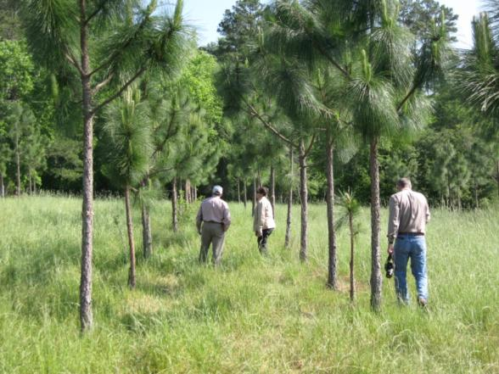
Annual Costs and Management
Annual costs may include:
Herbicides for continued management of competition
Tree pruning (beginning around year 5 after establishment)
Fencing and maintenance
Fertilizer applications
Watering facilities for cattle
Forage or other annual crop seed
Pre-commercial thinning
{Lecture 1b} Slide: 6/11

Slide 7
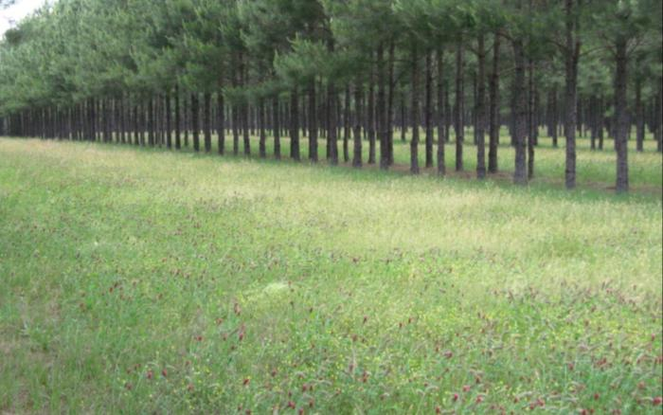
Forage Costs
Cost estimates for forage management may include approximately:
Establishment (seed+ planting costs + labor and equipment) = $275
Annual nutrient costs - $85
Annual Hay Harvesting Costs $20/ton = $60
Periodic lime cost every 5 years = $24
{Lecture 1b} Slide: 7/11

Slide 8
Forage Management Economic Savings
Important points to consider:
Stress on cattle can decrease feed efficiency by as much as 20%. Therefore, if the average feed bill on open pasture is $150 per animal unit, a silvopasture system can save the farmer about $30 per animal unit annually due to reduced stress
The increased grazing period resulting from a well-managed forage rotation less affected by early fall/late spring frosts can reduce feed costs by as much as $25 per animal unit per year
Reduction in fertilizer and herbicides can save as much as $15 per acre
Nutrient cycling can save up to $5 per acre
Grazing can eliminate the cost of mechanical or chemical competition control in mid-rotation pine plantations
{Lecture 1b} Slide: 8/11

Slide 9
Cost-Share Opportunities
Certain establishment and management expenses may be cost-shared:
USDA’s Forest Land Enhancement Program (FLEP) provides cost sharing (reimbursement) opportunities for silvopasture “implementation, establishment, maintenance and renovation.”
As of 2007, FLEP allows treatment of up to 1,000 acres per year and the maximum FLEP cost-share payment for any practice may be up to 75 percent.
For information about how FLEP will operate in your state, please contact your State Forestry agency.
{Lecture 1b} Slide: 9/11

Slide 10
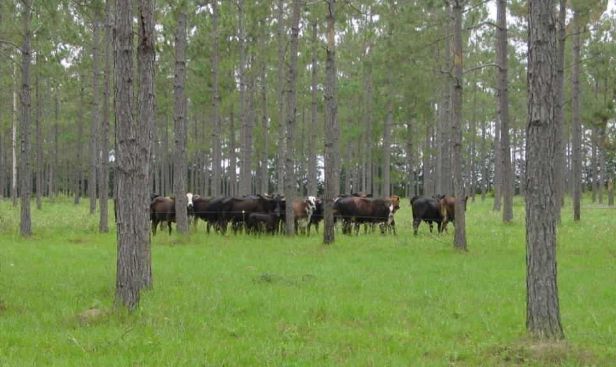
Tax Considerations
It is important to research your state or county’s land-use taxation policies. Silvopasture may qualify as an agriculture practice or forestry depending on interpretation.
{Lecture 1b} Slide: 10/11

Slide 11
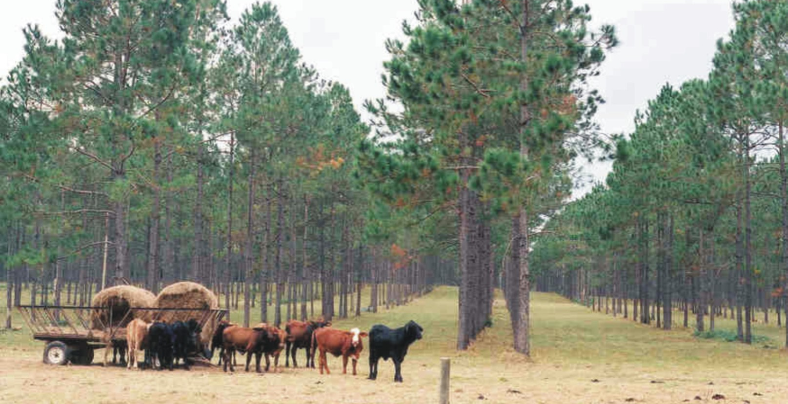
Summary
A well-managed silvopasture can yield short and long-term economic benefits. However, it is important to plan ahead and understand the up-front and periodic costs that proper management of a silvopasture will include.
{Lecture 1b} Slide: 11/11

