Slide 1
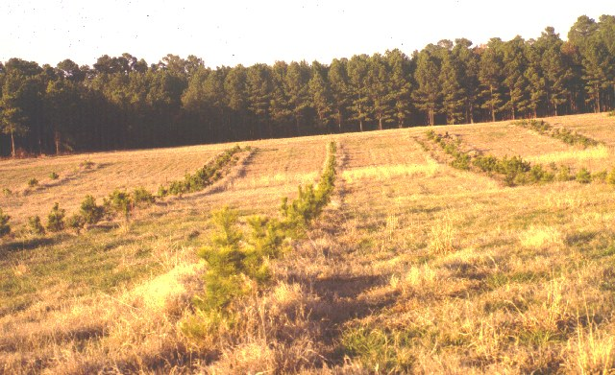
module #2
Tree Spacing and Row Arrangement
Pine Silvopasture in the Southeast

Slide 2
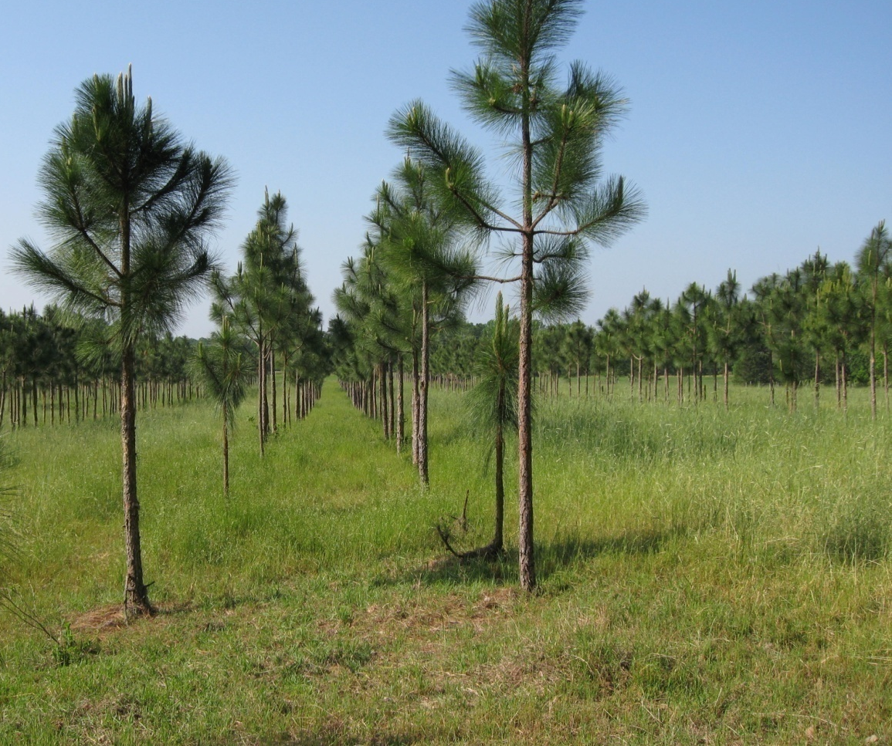
Getting Started
Trees in a silvopasture system are planted at much lower densities than traditional forestry plantations.
A healthy planting range for silvopasture establishment is typically between 200-400 trees per acre.
{Lecture 2a} Slide: 2/10

Slide 3
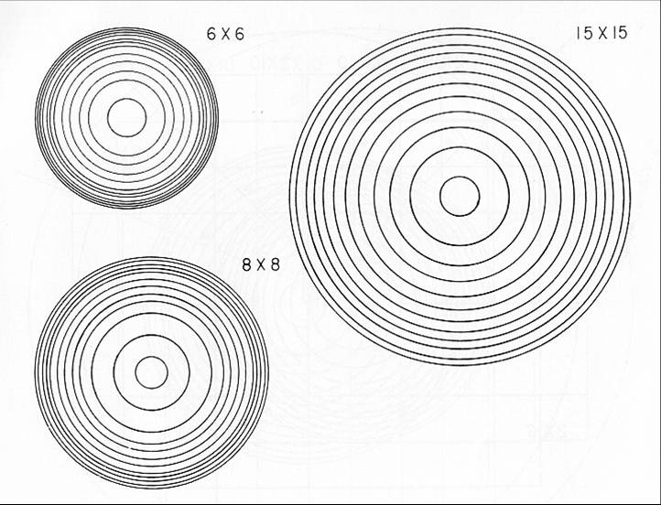

Lower Density Effect on Tree Diameter
Tree diameter growth in lower density stands is accelerated due to reduced competition. Proper tree pattern will produce larger logs. For harvested logs (stumpage), size is valued more than number of rings per inch.
Dimensions indicate spacing (in feet) of trees.
{Lecture 2a} Slide: 3/10

Slide 4
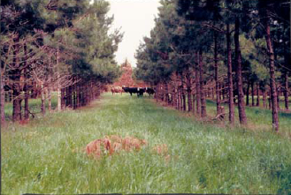
Lower Density Effect on Forage and Cattle
Lower density stands permit enough sunlight to penetrate to the forest floor to stimulate forage growth. Shade allows cattle to graze throughout the day with reduced sun stress.
{Lecture 2a} Slide: 4/10

Slide 5
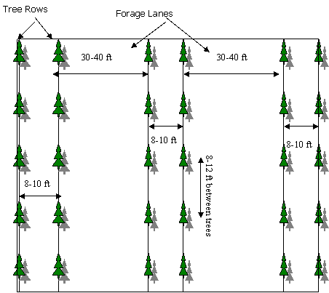
Spacing
An 8x8-40 feet arrangement (i.e. 8 feet between trees within a row, 8 feet between tree rows, and 30-40 feet for forage alleys between tree row sets) yields roughly 250 Trees Per Acre
{Lecture 2a} Slide: 5/10

Slide 6

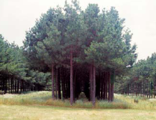
The Double Row System
Double row systems are considered optimal.
While triple and quadruple rows have been used in silvopasture, it has been found that ‘middle-row’ trees typically grow more narrow and have poorer quality due to competition from the ‘outer-row’ trees.
{Lecture 2a} Slide: 6/10

Slide 7
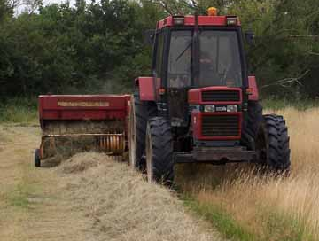
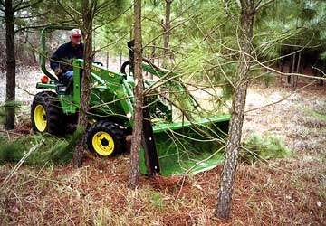

Alley Widths
When setting the alley width, consider the width of the equipment that will be used in the management of the forages and plant the width of the alleys accordingly.
Avoid contacting seedlings and trees with equipment
{Lecture 2a} Slide: 7/10

Slide 8
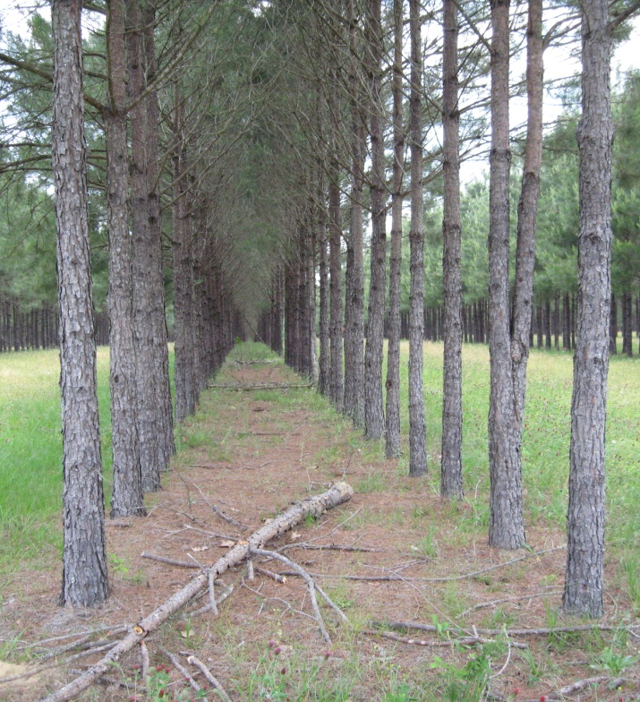
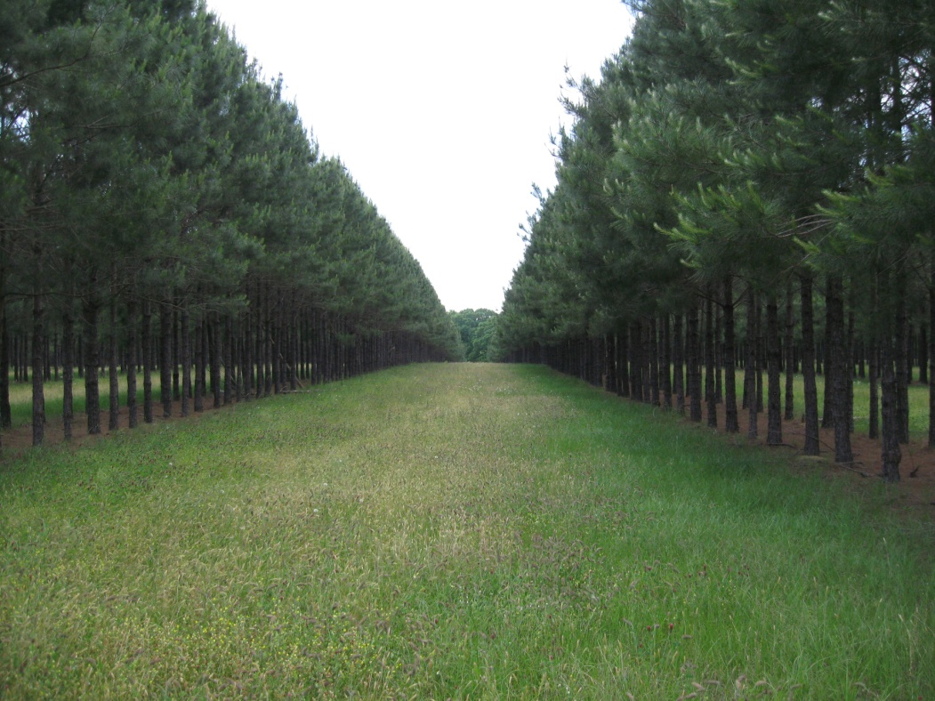
Canopy Dynamics
As trees mature, the canopy closes between rows. Canopy density in a silvopasture system is generally managed between 25-60% which provides larger open spaces for forage production and management.
{Lecture 2a} Slide: 8/10

Slide 9
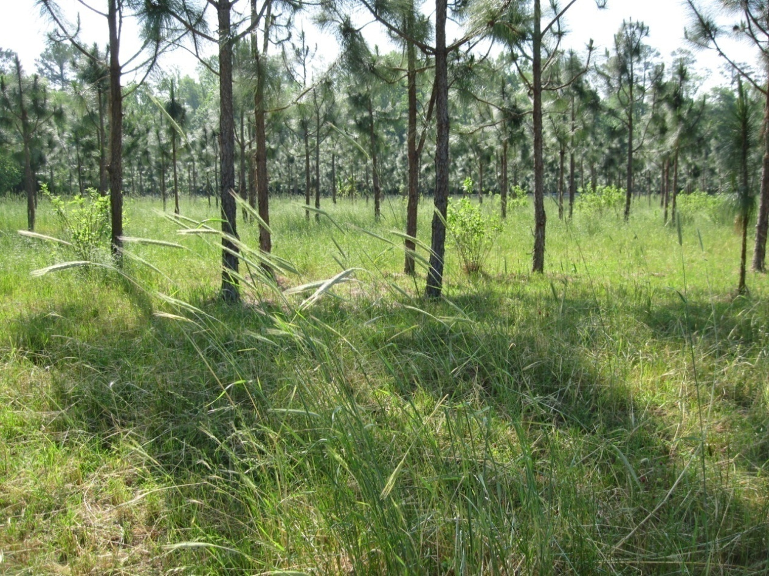
An Integrated System
Once established, both forages and trees co-exist and can contribute to a highly productive silvopasture system.
{Lecture 2a} Slide: 9/10

Slide 10
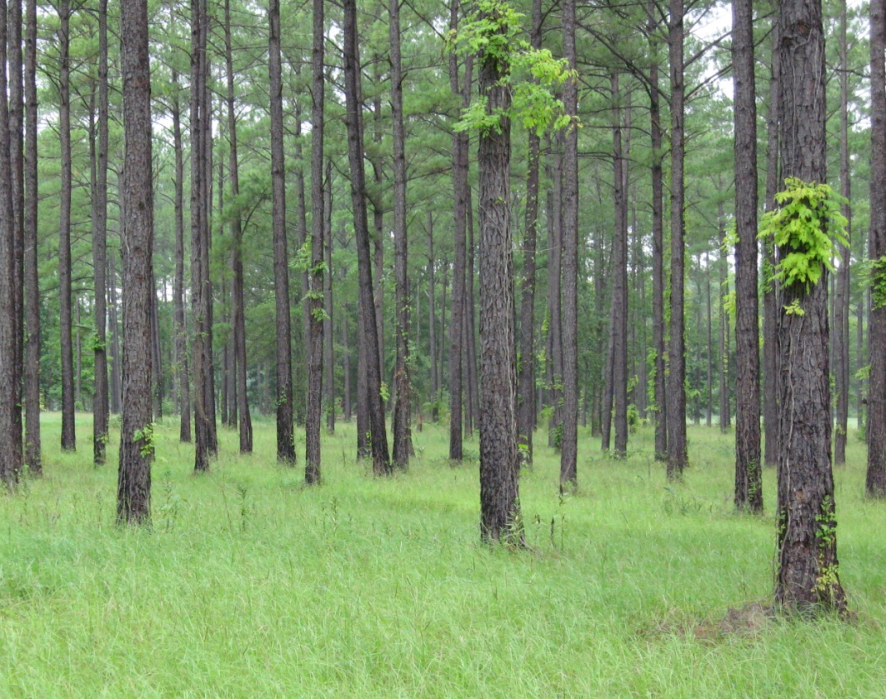

Summary
Site conditions and producer objectives should ultimately dictate the desired planting arrangement.
Whether you chose a single or double row system to establish silvopasture in an existing pasture, or convert an existing stand, proper tree spacing and row arrangement is key to the production of high quality forage in the short term and sawtimber in the long run.
{Lecture 2a} Slide: 10/10

