Slide 1
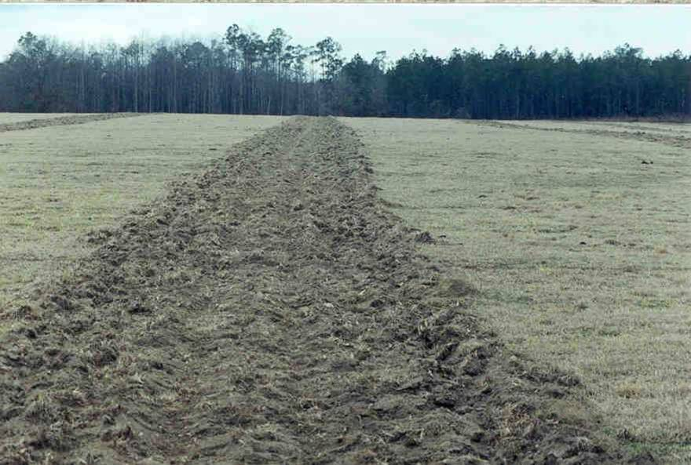
module #2
Site Preparation
Pine Silvopasture in the Southeast

Slide 2
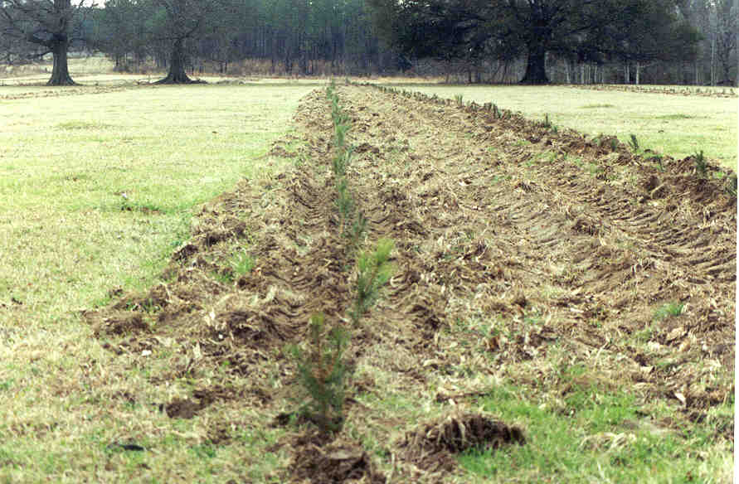
Pasture Conversion
An existing pasture can be easily converted to a silvopasture with proper site preparation. If pasture land has been regularly grazed and has minimal weeds, rows for planting seedlings can be established at desired intervals
{Lecture 2b} Slide: 2/10

Slide 3
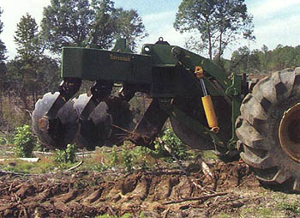
Soil Preparation
In order to establish tree seedlings in existing pastures, tilling and subsoiling are recommended to remove competition and to loosen up the soil from compaction typical of grazed pastures.
{Lecture 2b} Slide: 3/10

Slide 4
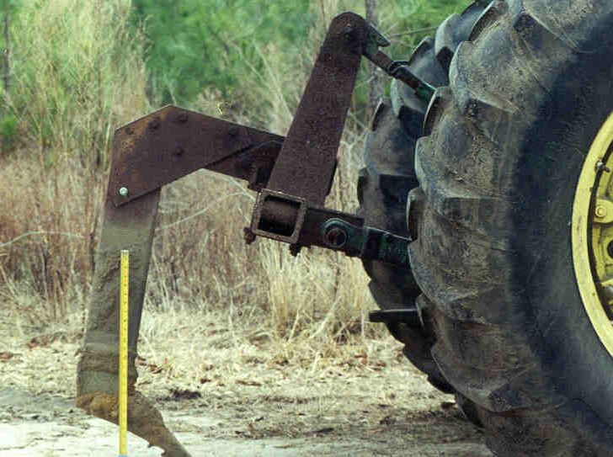
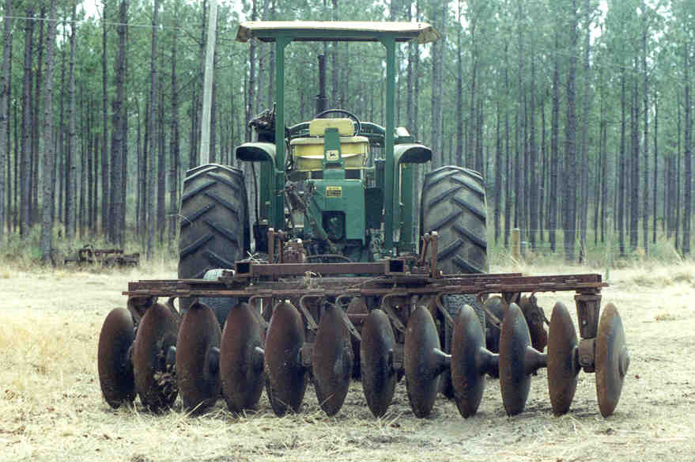
Subsoiling and Disking
A single-shank sub-soiler (see photo) that can rip to a depth of 18-24 inches is sufficient to provide water infiltration and space for new seedling roots to establish.
Disking can also help break up soil clumps and provide area for forage establishment.
{Lecture 2b} Slide: 4/10

Slide 5
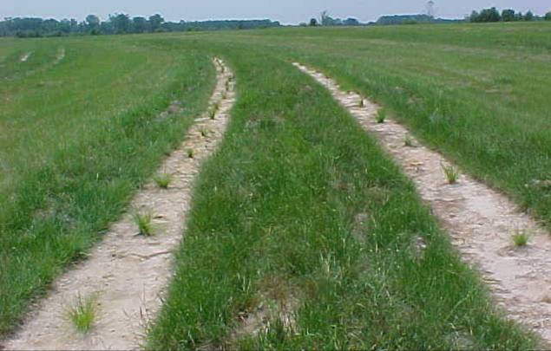
Contouring
Subsoiling should be carried out along the natural contour of the land to avoid erosion.
{Lecture 2b} Slide: 5/10

Slide 6
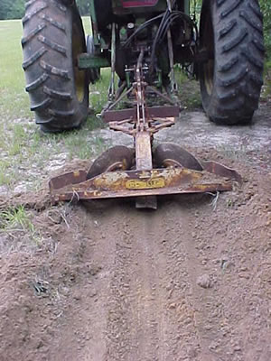
Scalping
Scalping is the practice of removing grass cover by mechanically peeling back sod to a depth of 4-5 inches.
Because grasses are such serious competitors for tree seedlings, scalping can increase seedling survival and growth on converted croplands or pasture.
Herbicides can also be used to chemically scalp an area to be planted.
Fire plows or specialized ‘scalpers’ can be used.
{Lecture 2b} Slide: 6/10

Slide 7
Herbicide Treatments
Herbicide treatments after planting trees are recommended for better tree survival. Weeds will often quickly reestablish in newly planted rows even after scalping or disking.
Banded or spot-herbicides use along tree rows during the first two years after planting is effective in controlling unwanted vegetation.
{Lecture 2b} Slide: 7/10

Slide 8
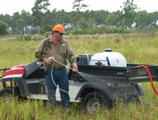
Herbicides
A number of herbicides are available for weed and grass control. Oust, Oustar, Arsenal, Fusilade, RoundUp, Accord, Velpar are commonly used herbicides can be used as single treatments or as tank mixes for common grasses like Bahia and bermuda grass control.
While some herbicides are labeled that they can be sprayed “over the top” of seedlings, it is recommended to avoid direct contact with seedlings while spraying.
Product labels for herbicides should be followed for mixing and application rates
{Lecture 2b} Slide: 8/10

Slide 9
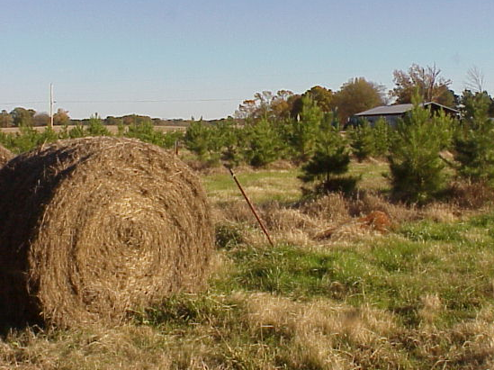
Mowing and Haying
Mowing between tree rows during the first three growing seasons after tree planting will help reduce weed and grass competition .
Where possible, haying can also provide revenue from forage (or defray costs) before cattle are allowed to graze the site.
Avoid contacting seedlings with equipment
{Lecture 2b} Slide: 9/10

Slide 10
Summary
Site Preparation is perhaps one of the most important steps in establishing a high-quality silvopasture and may include:
Disking
Subsoiling or ripping
Scalping
Herbicide treatments
Each of these methods are used to loosen the soil for good root growth and/or to reduce the level of competition from weeds until trees can become established
{Lecture 2b} Slide: 10/10

