Slide 1
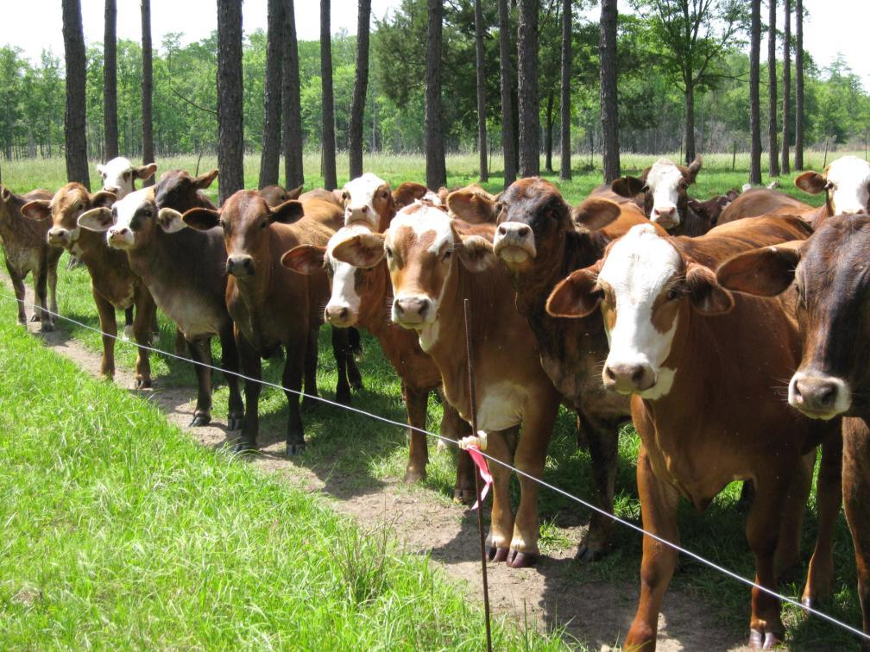
module #5
Livestock Management: Fencing and Watering
Pine Silvopasture in the Southeast

Slide 2
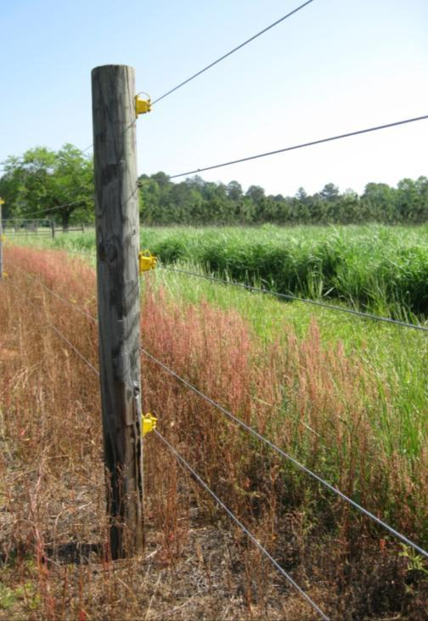
Fencing
Proper fencing is a necessary component to reduce overgrazing in an efficient rotational grazing system.
Fencing plans should follow NRCS specifications, Extension publications or guides published by reputable fencing companies for requirements to meet local environmental conditions and special livestock
considerations.
Fencing between paddocks should consist of 4 to 6 wire strands for border fencing and 1 to 3 strands for cross-fencing.
{Lecture 5a} Slide: 2/11

Slide 3
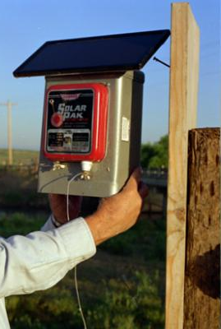
Energized Fences
Energized fences can be easily installed and provide a psychological deterrent when the fence carries proper current.
AC-powered units are the best choice for energizing a fence if 220 or 110 volt power is available.
Solar-recharging battery systems can be installed on site. A properly installed energizer should produce 1 joule per mile of fence.
{Lecture 5a} Slide: 3/11

Slide 4
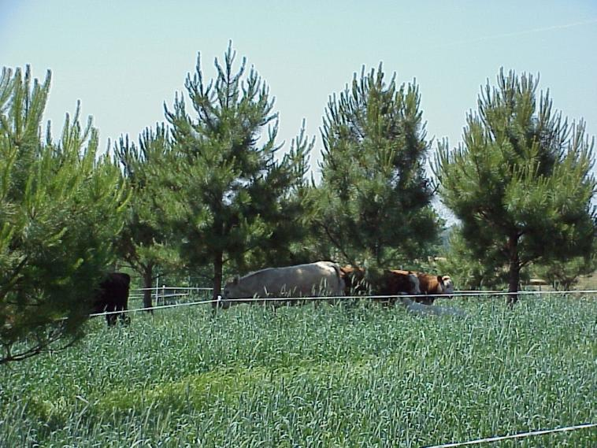
Portable Fencing
Polywire or polytape can be used for temporary or portable cross fencing to create smaller paddocks for intensive grazing or to allocate stockpiled pastures for winter grazing.
Electrified polytape is very visible and easy to use for dividing a pasture. Polytape flutters in the wind making it more visible as well.
{Lecture 5a} Slide: 4/11

Slide 5
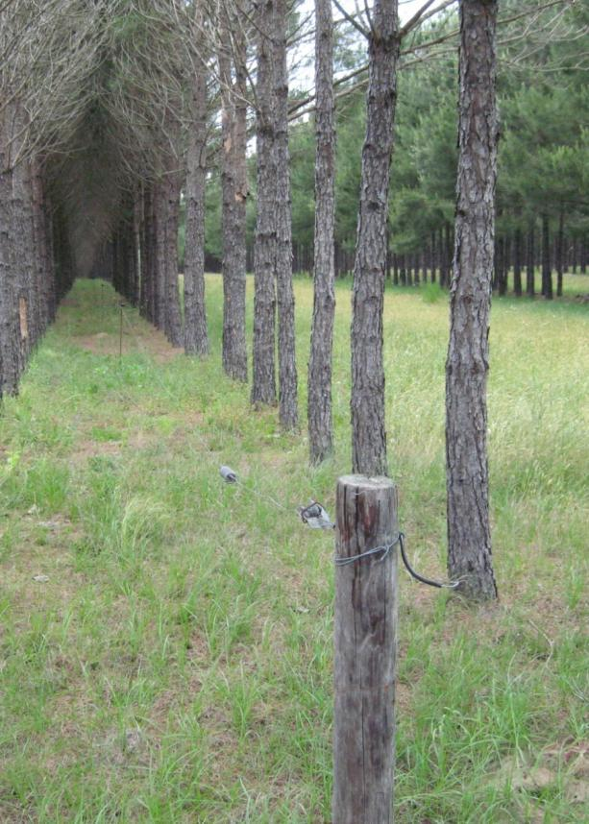
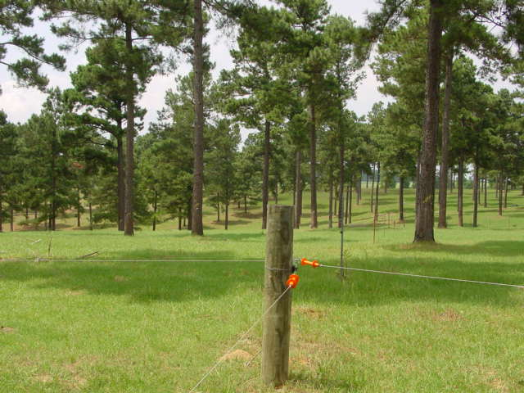
Paddock Fencing
Paddocks can be easily established with energized polywire fencing and moved as needed when cattle are accustomed to fencing.
{Lecture 5a} Slide: 5/11

Slide 6
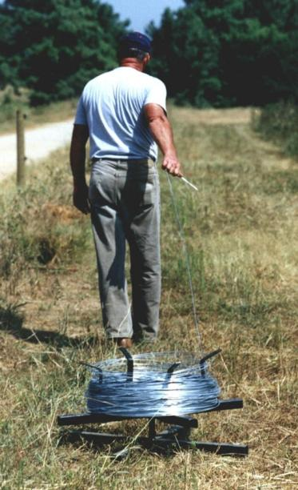
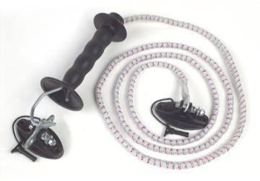
Fencing tools
A few simple tools are useful when using energized fencing as part of the grazing system:
"Spinner" – Before installing high tensile wire, acquire a "spinner" to reel out the wire without adding twists.
In-line switch – A wise investment: by strategically locating switches, a landowner can save miles of walking when tracing electrical current using a voltmeter.
Bungee-gates to ease movement between paddocks.
{Lecture 5a} Slide: 6/11

Slide 7
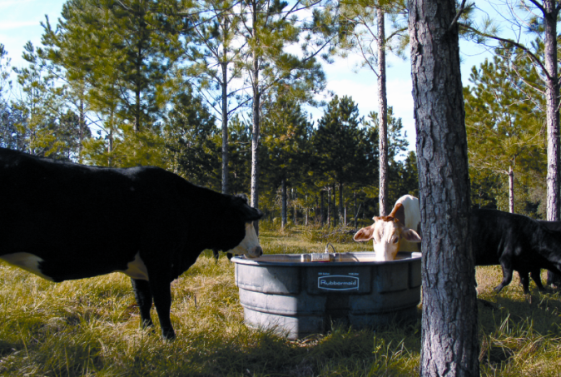
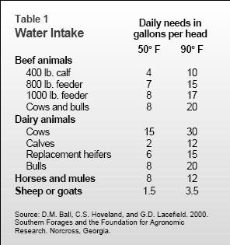
Watering
At 90 degrees Fahrenheit, a 600 pound growing steer needs about
13 gallons of water per day. At 60 degrees, that need falls to eight gallons per day. One distinct advantage of a silvopasture system is that shade is distributed throughout the pasture and greatly reduces high temperature stress on livestock.
{Lecture 5a} Slide: 7/11

Slide 8
Watering within Paddocks
Keep water source within 600-800 feet of cattle, but avoid placing portable water tanks in the center of a paddock system. When forage resources are far from water supply, cattle move back and forth to the water as a herd. This limits the number of times per day that animals water, and the total consumption of both water and forage.
OK
Not OK
{Lecture 5a} Slide: 8/11

Slide 9
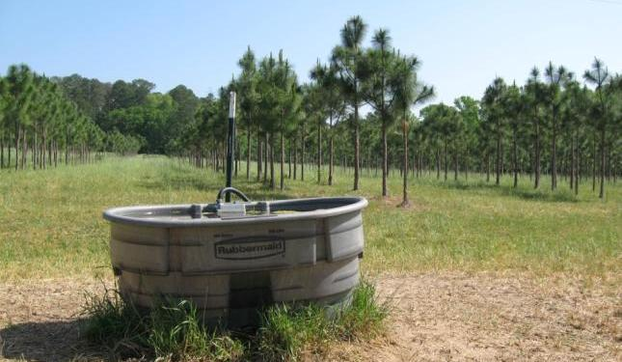
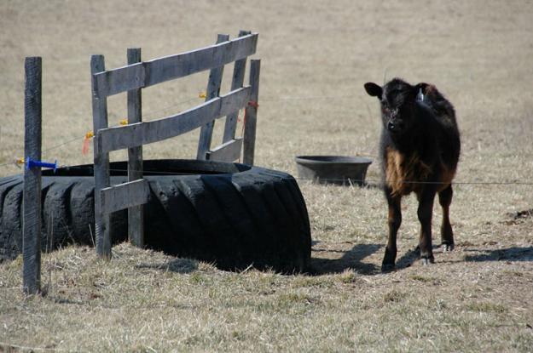
Water Tank Considerations
Consider using portable water tanks that can be moved easily between paddocks.
If installing permanent tanks, consider concrete tanks and tank covers. Heavy equipment tires are also a popular, durable choice. Cleaning the inside of tanks may be necessary to remove calcium residues and algae.
{Lecture 5a} Slide: 9/11

Slide 10
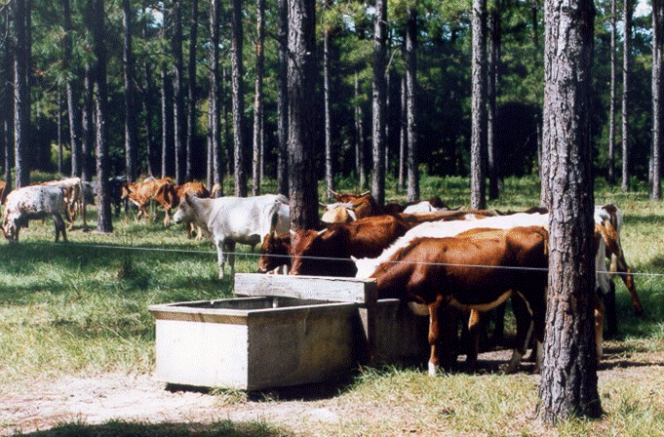
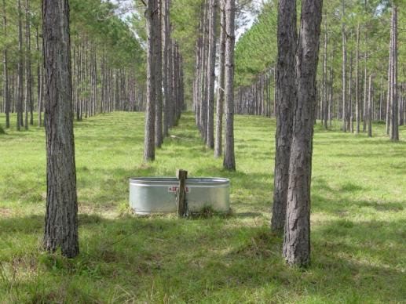
Watering within Paddocks
When water is close to forage, the herd's "social structure" keeps animals watering more frequently as individuals.
This keeps the herd dispersed throughout the paddock and results in a greater portion of time spent grazing.
{Lecture 5a} Slide: 10/11

Slide 11
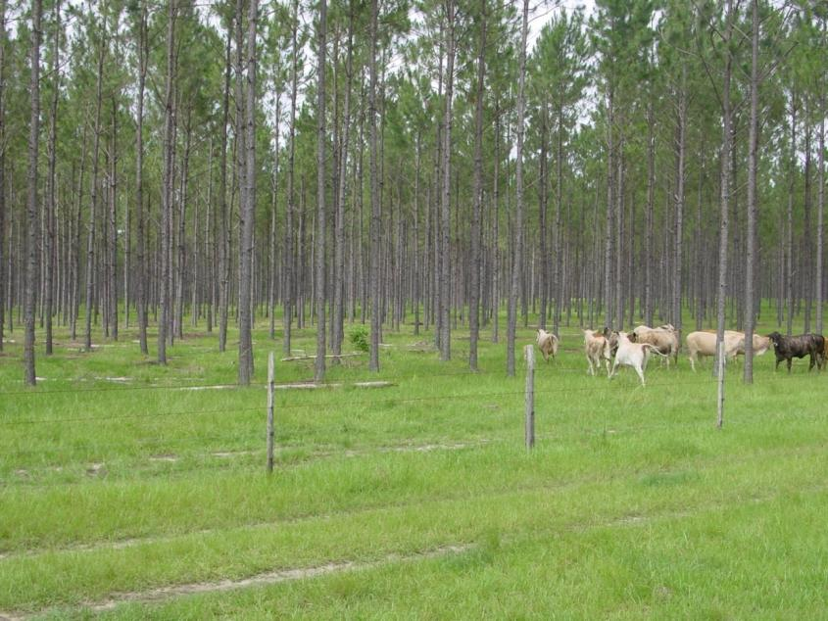
Summary
Advances in livestock watering systems design and fencing materials have made rotational grazing convenient and affordable.
However, some special considerations must be given to water and fencing in a silvopasture system.
{Lecture 5a} Slide: 11/11

