Slide 1
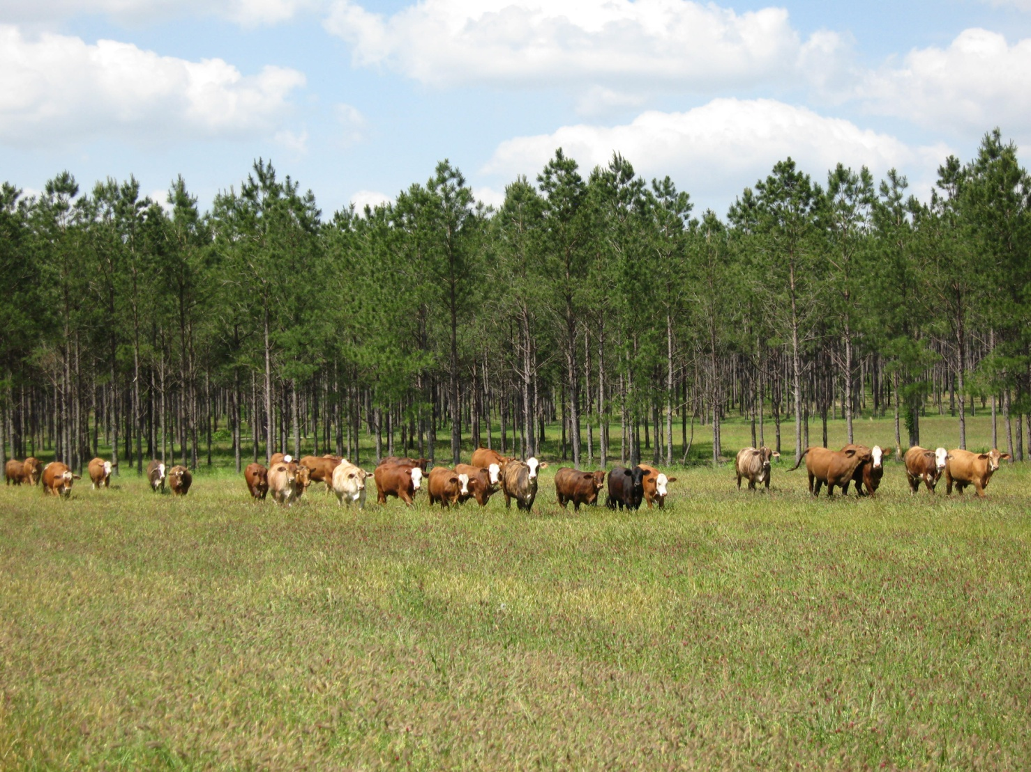
module #5
Livestock Management: Rotational Grazing
Pine Silvopasture in the Southeast

Slide 2
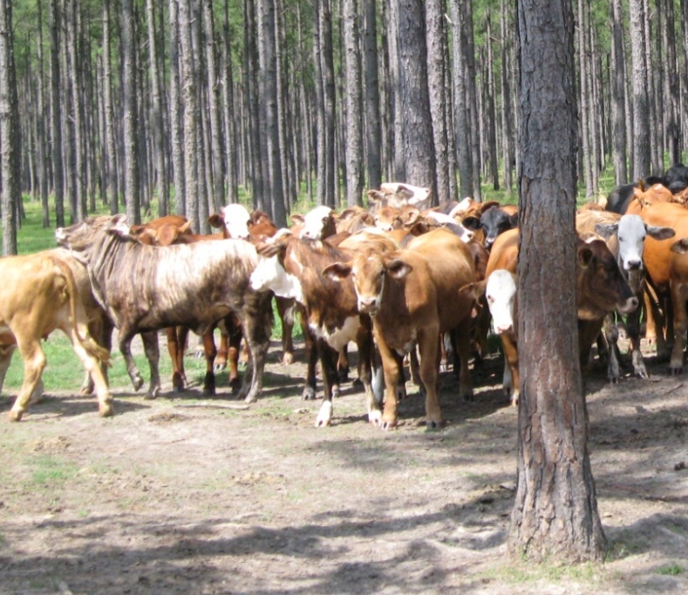
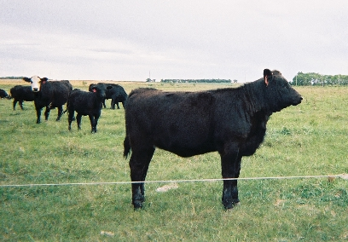
Rotational Grazing for Silvopasture
High impact areas associated
with traditional grazing can
have detrimental impacts on tree growth and survival and lead to soil erosion.
For a well-managed silvopasture, rotational grazing is recommended. Rotational grazing involves using several pastures with one being grazed while the others recuperate.
{Lecture 5b} Slide: 2/11

Slide 3
Rotational vs. Continuous Grazing
Traditional stocking systems involve continuously grazing animals on a single pasture throughout the entire grazing season.
Rotational grazing yields higher quality pastures and favors the sustainable production of legumes and other desirable forage species.
Rotational grazing vs. continuous grazing
{Lecture 5b} Slide: 3/11

Slide 4
Considerations for Rotational Grazing
Advantages:
Drawbacks:
Reduces supplemental feeding
and pasture waste.
Improves forage composition
and yield.
Improves animal waste
distribution
Minimizes daily fluctuations in
intake and quality feed.
Allocate pasture to animals
more efficiently, based on
nutritional needs.
Typically entails more
management, time, & labor
than continuous grazing
Requires more fence & water
facilities
Requires a good understanding
of forage growth cycles &
regrowth
More cattle in smaller areas
can result in mud & soil
compaction—must be
monitored
{Lecture 5b} Slide: 4/11

Slide 5
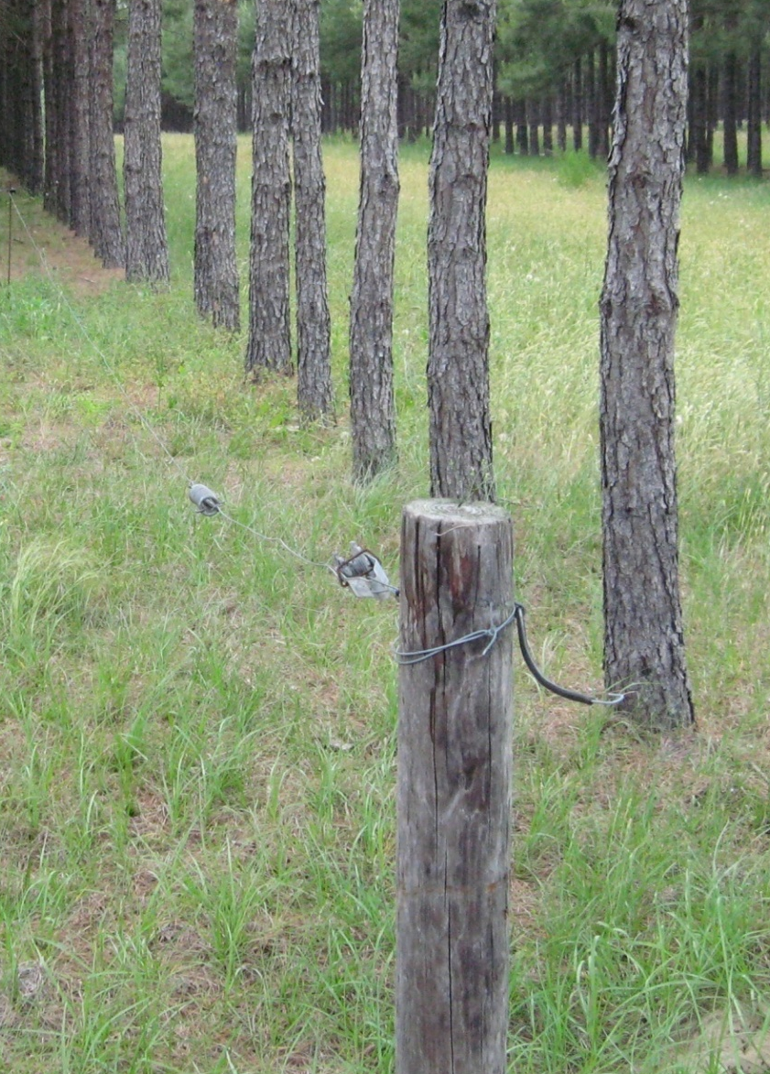
Paddocks
Managers can use a versatile fencing strategy to utilize pasture blocks, or paddocks, more efficiently to control pasture allocation.
This allows animals to be rotated to new grazing areas before they graze the new regrowth of forage plants--
allowing a sufficient recovery period for forages.
{Lecture 5b} Slide: 5/11

Slide 6

Paddocks
Paddocks should be laid out
as squarely as possible and
on similar soil type. Square paddocks require less fencing to enclose a given area and reduce distances to water.
Square paddocks also generally result in more
even manure distribution
than paddocks of other shapes. However, adjustments must be made for the soil productivity and the lay of the land.
Rectangular paddocks should not be more than four times as long as they are wide.
{Lecture 5b} Slide: 6/11

Slide 7
Paddock Design for Rotational Grazing
A producer new to intensive rotational grazing may want to start with 4 or 5 paddocks and then move up to 8 or 10. Watering structures can be arranged to best facilitate access for livestock.
{Lecture 5b} Slide: 7/11

Slide 8
Design Considerations for Streams
Landowners can receive cost-share funds to fence stream areas from livestock grazing. This in many areas is a very economical alternative use for the protection of water quality. However, streams on properties can be integrated into smaller paddocks for short-duration grazing while still protecting the stream and water quality.
Stream fenced off
water access
{Lecture 5b} Slide: 8/11

Slide 9
Gates, Lanes, and Alleyways
The location of gates in the rotational system is very important to help facilitate the movement of livestock through the paddock and the alignment of temporary lanes and alleyways.
Temporary lane
{Lecture 5b} Slide: 9/11

Slide 10
Layout and Design
Stream X
well
Forest Riparian Buffer
Experiment with design using aerial property photos. For most typical beef cattle operations in the southeast, 5 to 10 paddocks may be sufficient. This allows paddocks to be grazed for 3 to 7 days, then rested for a month.
{Lecture 5b} Slide: 10/11

Slide 11
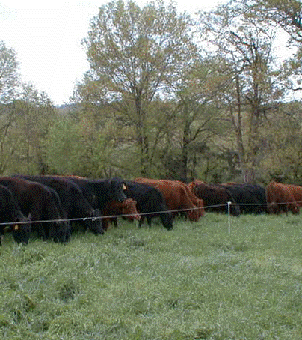
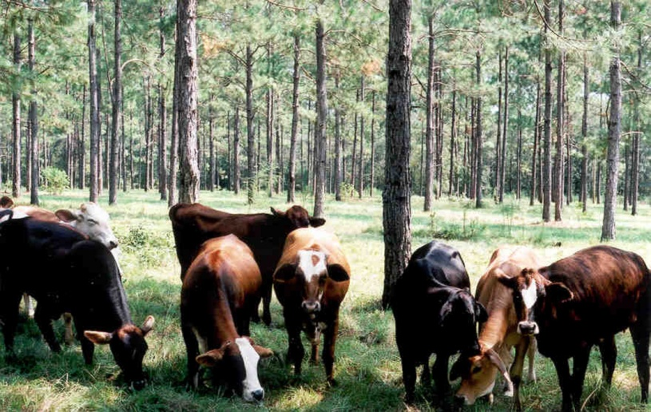
Summary
A rotational grazing system with paddocks gives the manager greater control.
Designing a pasture system involves many decisions, including number and size of paddocks, the location of water sources, and lane placement and livestock flow.
The most important factor in developing a rotational grazing system is to develop one that is right for the landowner, the farm's resources, and the land's capabilities.
{Lecture 5b} Slide: 11/11

