Slide 1
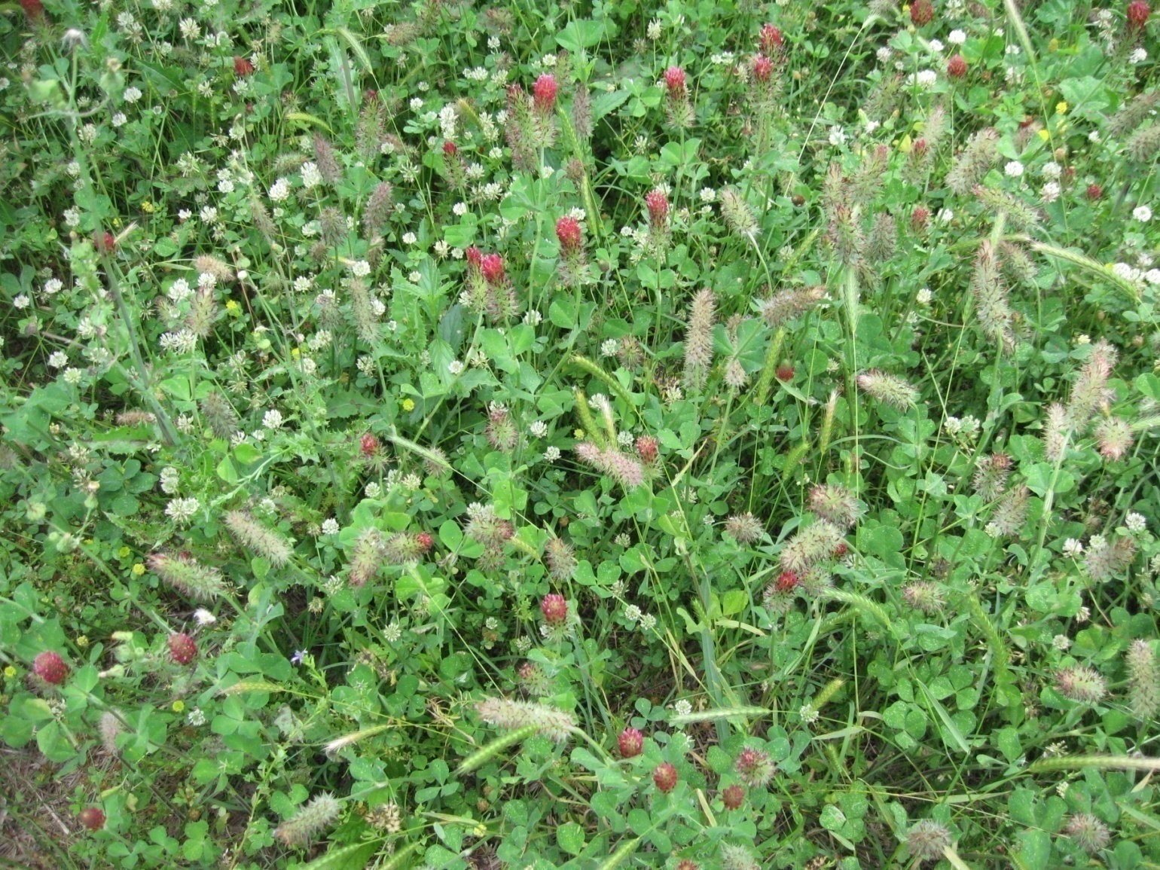
module #6
Forage Selection
Pine Silvopasture in the Southeast

Slide 2
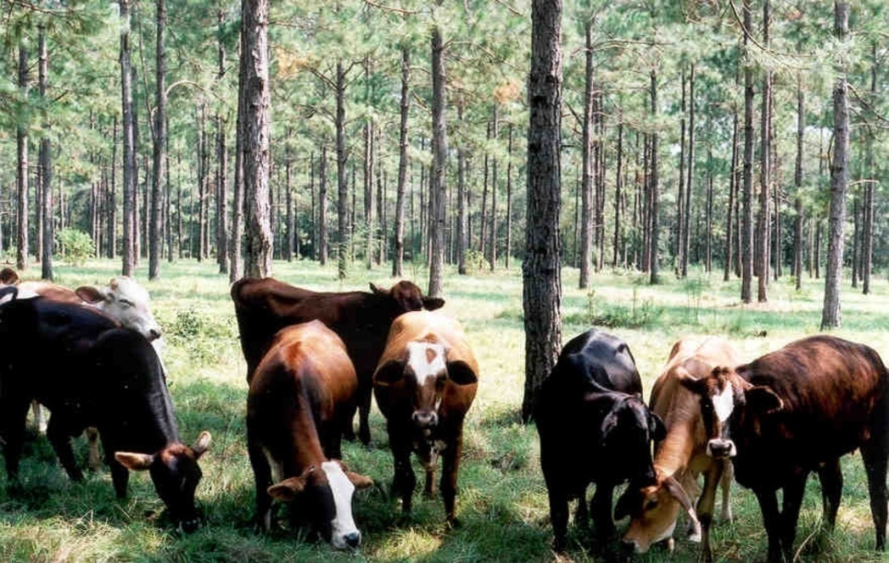

Forage options
There is no “all-season” plant available that can serve effectively as a year-round forage. Producers must recognize the limitations and benefits of a plant’s seasonality.
Therefore incorporating both
cool and warm season grasses,
is essential to extend your
grazing season.
Incorporating native, non-
invasive forage species is also
recommended.
{Lecture 6a} Slide: 2/14

Slide 3
Geography and site considerations
The more northward you go, cool season grasses would be more desirable, while warm season forages make up a larger portion of
a grazing system in the South. With new forage establishment, it may be necessary to implement herbicide management or prescribed burning to allow desirable forage species to establish or reestablish. Forages also have soil moisture and pH preferences that need to be taken into consideration.
The following slides show a range of common forage grasses—both native and introduced—and provide general information on each.
{Lecture 6a} Slide: 3/14

Slide 4
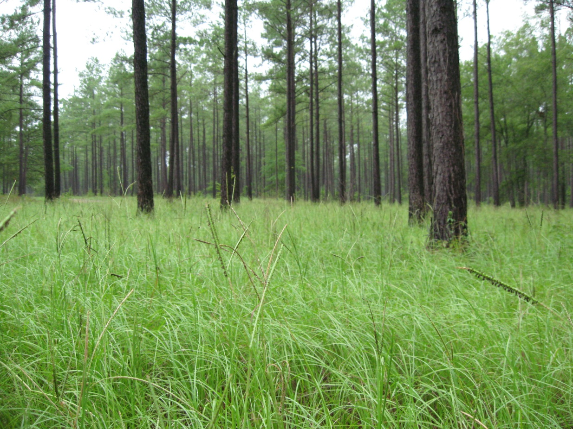
Bahiagrass
Optimal production
February through October
Tolerates wide range
of soil types
Good for brood cow
maintenance
Produces fair hay
Good drought tolerance
{Lecture 6a} Slide: 4/14

Slide 5
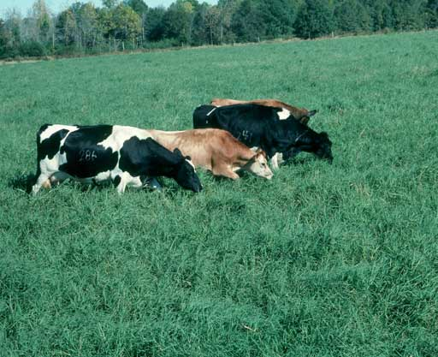
Hybrid Bermudagrass
Optimal production March
through mid-August
Versatile
Drought tolerant
Contains more dry matter
than other forages when
cut for hay (25 to 30%)
{Lecture 6a} Slide: 5/14

Slide 6
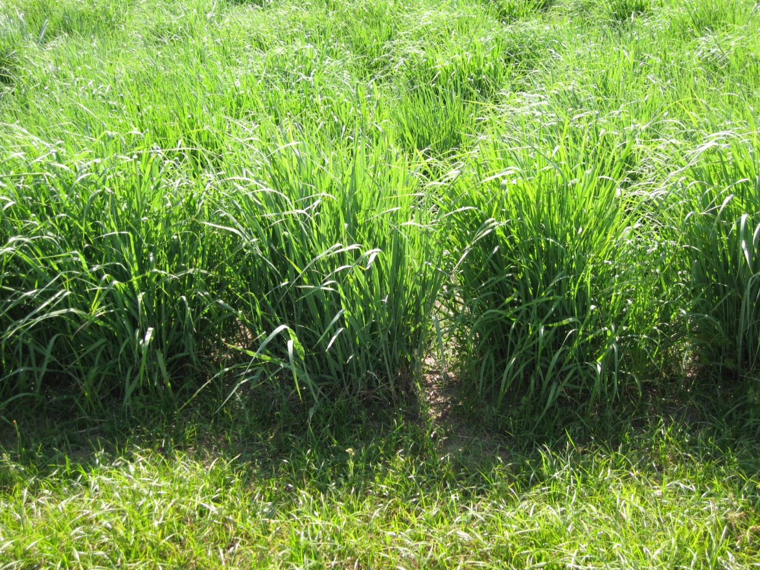
Eastern gamagrass
Optimal production
March through mid-July
A native that requires
moist, fertile sites and a
6 week chilling process
before planting
Highly productive in
rotational grazing
system: Up to 4 lbs/day
gain on steers
Prefers full sun
Good for wildlife habitat
{Lecture 6a} Slide: 6/14

Slide 7

White, Sub, and Crimson Clover
White Clover
Needs higher pH (6+)
Increases forage quality
Fixes nitrogen
Optimal production Oct. through
mid November
Sub clover
Needs fertile sites
Shade tolerant
Optimal production September-
October
Crimson clover
Excellent winter forage to mix with
other grasses
makes a good hay or cover crop
{Lecture 6a} Slide: 7/14

Slide 8
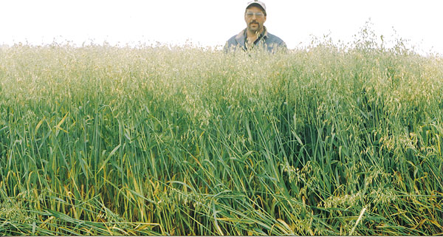
Small grains
Wheat, barley, oats, and rye are common small grain forages typically used as a supplement for growing cattle. An acre of small grain pasture can carry approximately 500 pounds of live weight per acre. Weaned calves can receive all needed protein and energy from good small grain pastures. Wheat, oats, and rye are good winter forages and cover crops.
{Lecture 6a} Slide: 8/14

Slide 9
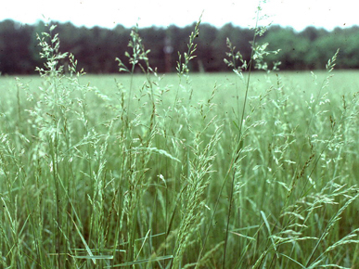
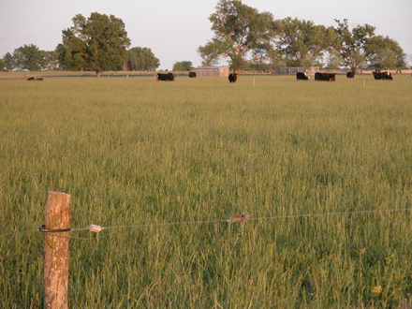
Endophyte free fescue
Fescue is one of the most commonly planted cool season perennial grasses for livestock forage.
A naturally occurring endophyte fungus can cause "fescue toxicosis" leading to poor weight gain and reproduction in animals consuming the forage.
For fescue, it is recommended that you plant or reestablish pasture with endophyte free varieties. However, this is up to producer.
{Lecture 6a} Slide: 9/14

Slide 10
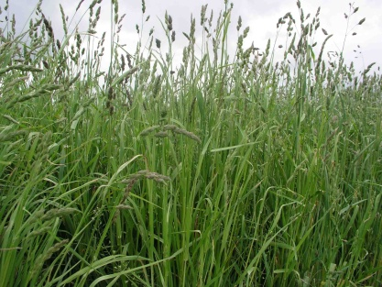
Orchardgrass
One of the most productive
cool-season grasses
Tolerant to shade
Fairly drought resistant
Moderate winter hardiness
Matures very early in the
spring
Can produce 2½ to 4 tons of
high quality forage per acre with
good fertility and management
{Lecture 6a} Slide: 10/14

Slide 11
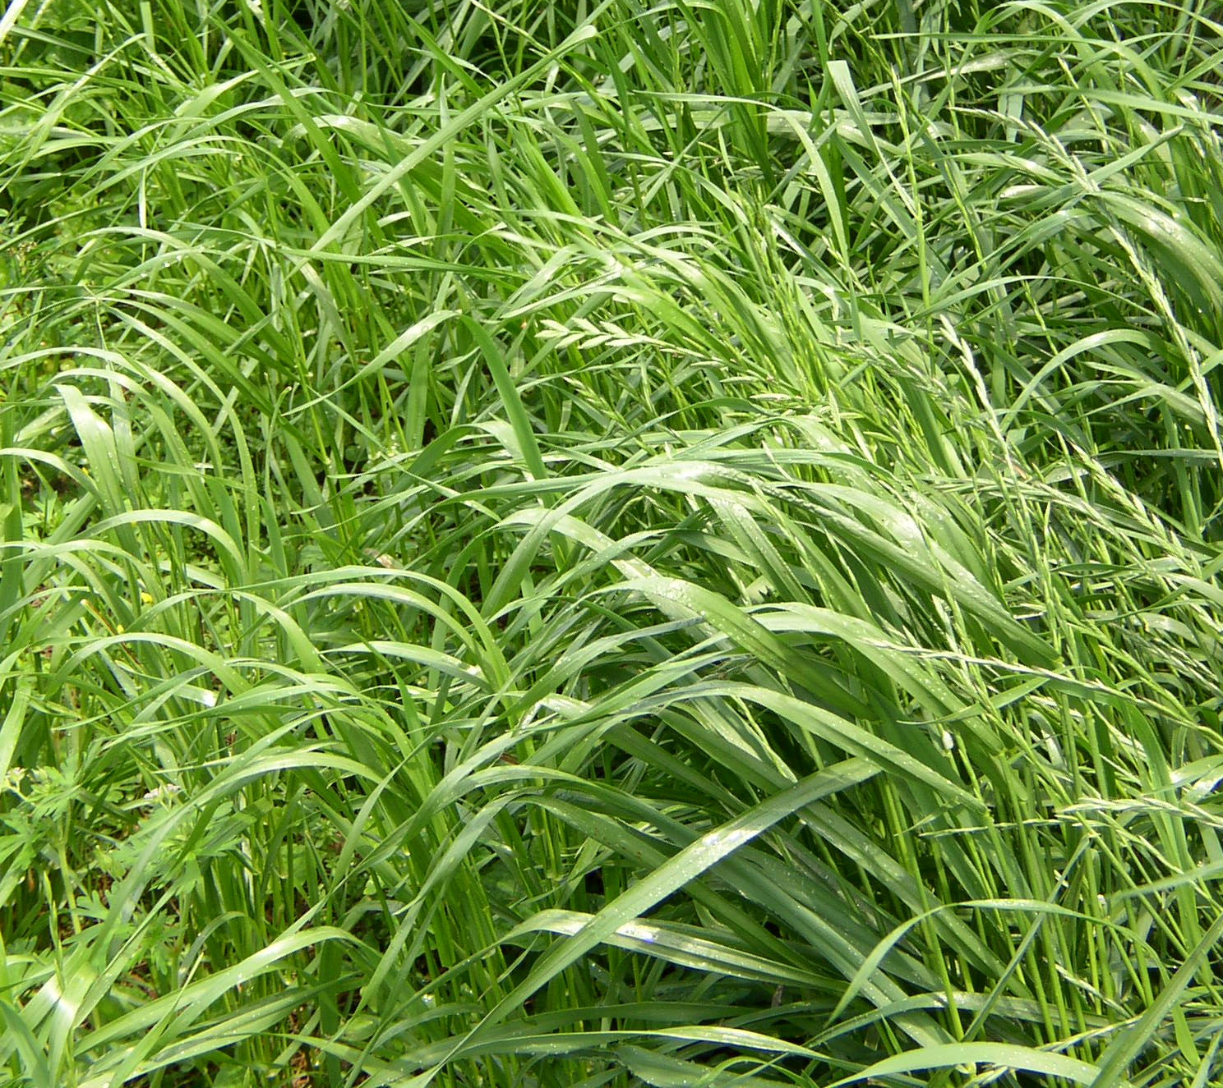
Annual or perennial ryegrass
Good winter forage for
cattle and wildlife
High palatability and
digestibility make this
species highly valued for
dairy and sheep forage
systems
High yield potential
Quickly established
Good choice for wet soils
{Lecture 6a} Slide: 11/14

Slide 12
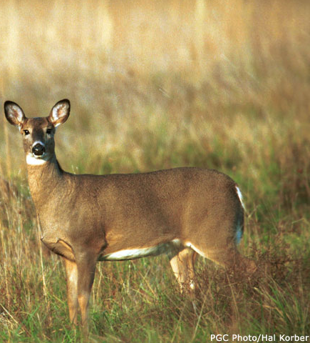
Native warm-season grasses
Switchgrass, big bluestem, little bluestem, and indiangrass are
the most common native warm-season grasses established and incorporated into pasture management. While seed can be expensive, native warm season grasses provide cattle with more nutritional diversity in their forage.
For example, big bluestem is an excellent summer forage that can produce almost 3 lbs/day on steers while indiangrass can produce 2 ½ lbs/day.
Deer in field of switchgrass
{Lecture 6a} Slide: 12/14

Slide 13
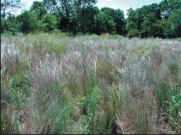
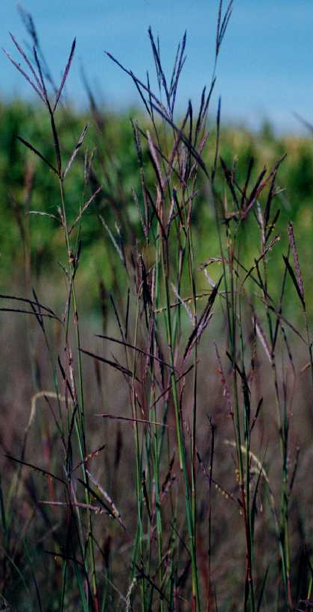
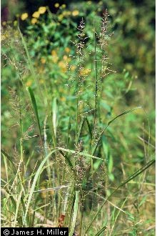
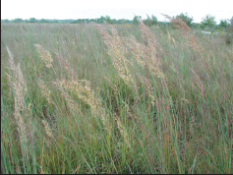
Native warm-season grasses
Switchgrass, big bluestem, little bluestem, and indiangrass: Optimal production March – June.
little bluestem
big bluestem
switchgrass
indiangrass
{Lecture 6a} Slide: 13/14

Slide 14
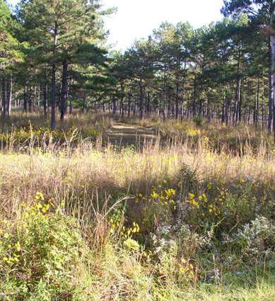
Summary
Native warm season grasses also are important if your goal is to improve wildlife habitat. Since acreage in native ‘grasslands’
has been greatly reduced due to pasture conversion to exotic forage species, wildlife species
will be attracted to a well-managed system.
If you have questions about the types of forages that are most appropriate for your area or property, consult with the NRCS or your local Cooperative Extension.
{Lecture 6a} Slide: 14/14

