Slide 1
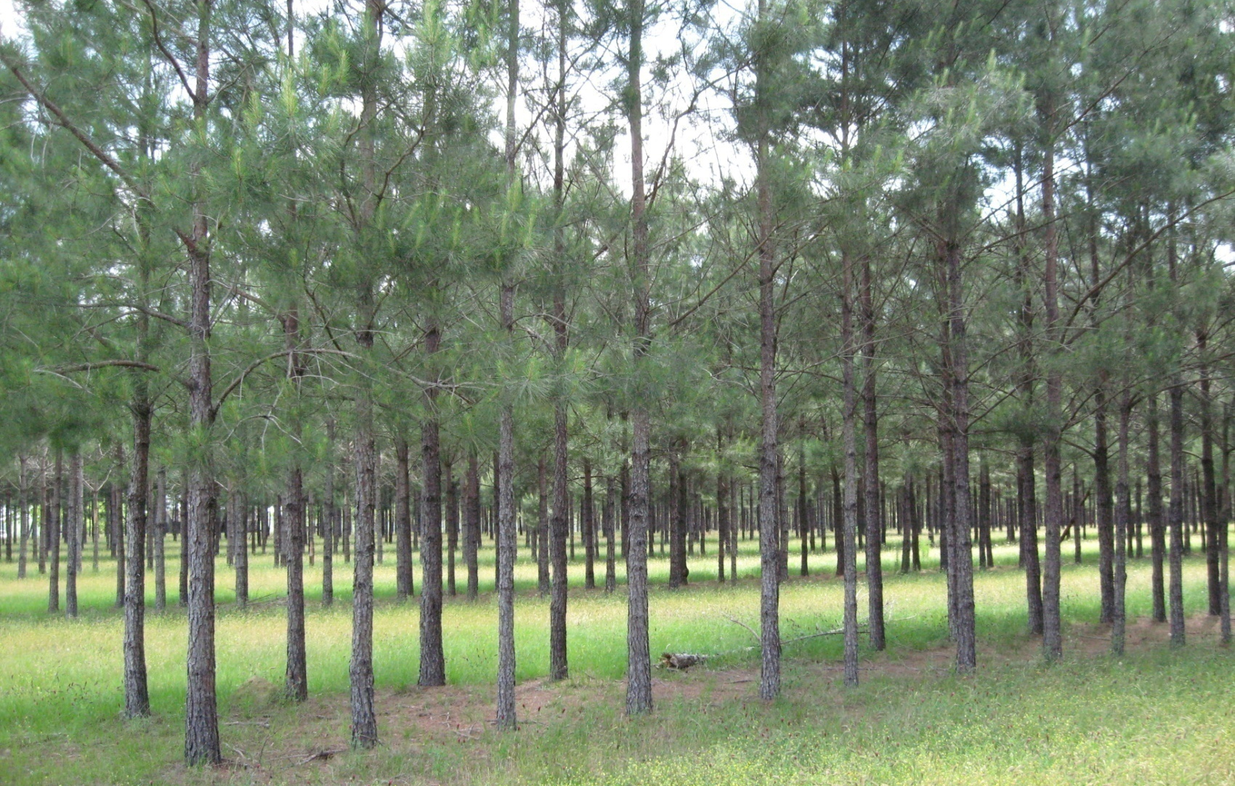
module #3
Pine Species for Silvopasture
Pine Silvopasture in the Southeast

Slide 2
Pine species for Silvopasture
The three pine species most recommended for silvopasture are:
Loblolly pine (Pinus taeda)
Slash pine (Pinus elliottii)
Longleaf pine (Pinus palustris)
Local soil, site, and climate conditions will dictate which species is best suited for your silvopasture. However, each of these species can produce high quality timber when managed properly. It is important to plant fusiform rust resistant seedlings for loblolly and slash pines.
{Lecture 3a} Slide: 2/13

Slide 3
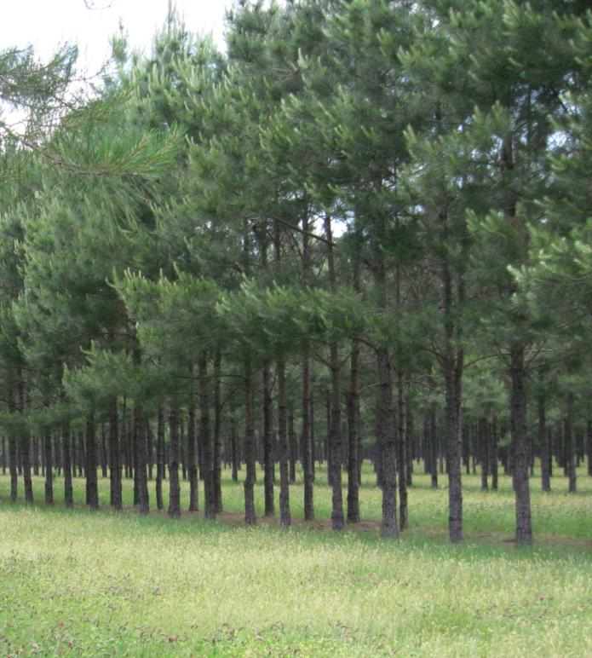
Loblolly Pine
Loblolly pine (Pinus taeda) is the most commonly planted commercial pine species in the southeast and has the fastest growth of the pine species.
Improved varieties of loblolly are also available to reduce rotation length.
{Lecture 3a} Slide: 3/13

Slide 4
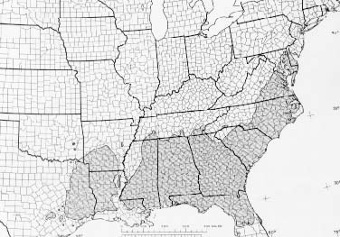
Loblolly Pine
Loblolly is best suited for well-drained upland areas or clay soils in much of the southeastern US.
It is the most versatile species in regards to range and site conditions
Loblolly also has the largest range of the southern pines.
{Lecture 3a} Slide: 4/13

Slide 5
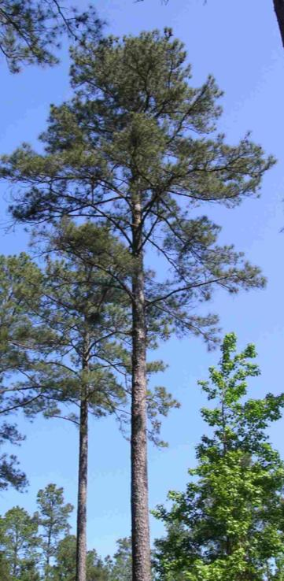
Loblolly Pine
Other considerations:
Produces larger branches that require more frequent pruning
Produces more shade which may influence forage selection
Can reach harvestable size for chip-and-saw and saw timber from 22-35 years in a well-managed silvopasture system.
Thinning for silvopasture management can also yield pulpwood at 12-15 years which can help defray management costs such as pruning.
{Lecture 3a} Slide: 5/13

Slide 6
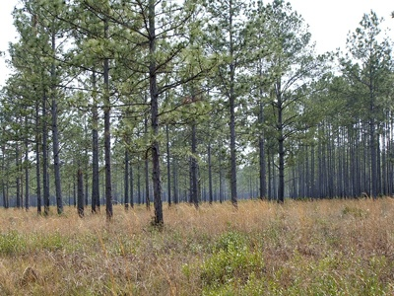
Slash Pine
Slash pine is suited for the more poorly drained sandy soils of the southeastern coastal plains.
It is considered an ideal silvopasture species because it self-prunes and produces less shade than loblolly which can benefit forage.
{Lecture 3a} Slide: 6/13

Slide 7
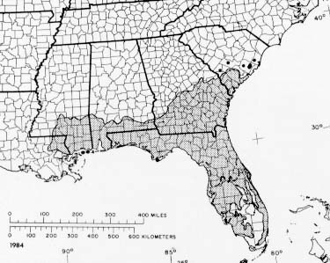
Slash Pine
Slash pine has a more limited range and site conditions than loblolly. It grows best in low-lying areas with good soil moisture but adequate drainage. It does not perform well in heavy clay soils nor deep, dry sandy soils.
{Lecture 3a} Slide: 7/13

Slide 8
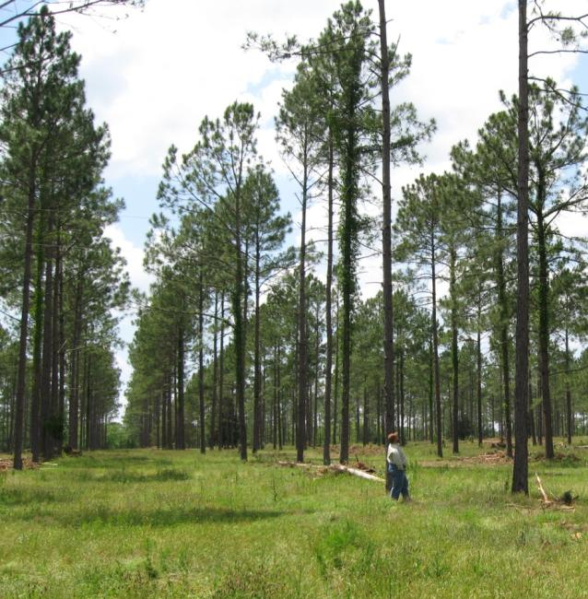
Slash Pine
Other considerations
Smaller branches susceptible to ice damage in northern latitudes
Can yield good pine straw production
Not as fire tolerant as longleaf pine—more careful burning required
Can yield chip and saw and saw timber from 22-35 years
{Lecture 3a} Slide: 8/13

Slide 9
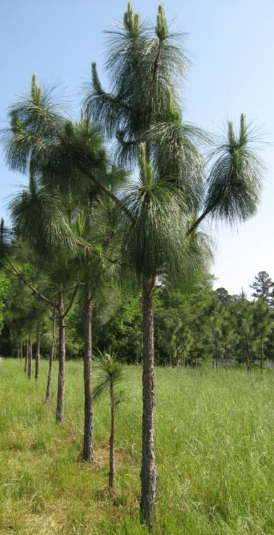
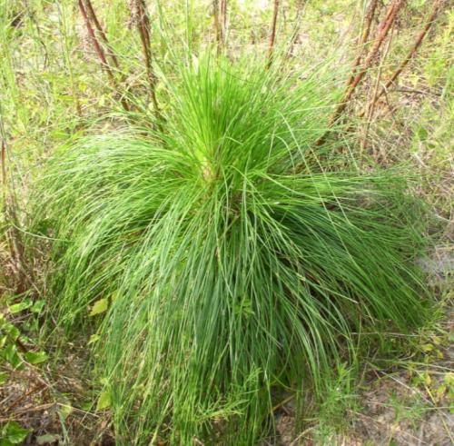
Longleaf Pine
Longleaf pine produces very high quality timber when properly managed.
Longleaf has traditionally had a longer rotation cycle than other pines. However, with proper burning and/or herbicide use, longleaf seedlings can escape their “grass stage” and initiate height growth sooner to reduce rotation length.
{Lecture 3a} Slide: 9/13

Slide 10
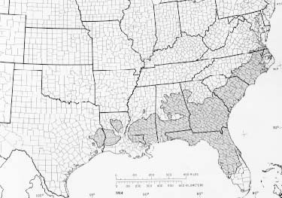
Longleaf Pine
Longleaf used to cover around 2/3 of the southeast and can be planted on a wide variety of sites.
It is well-suited for dry and infertile soils, but does not grow well in flooded, saturated, or heavy clay soils.
{Lecture 3a} Slide: 10/13

Slide 11
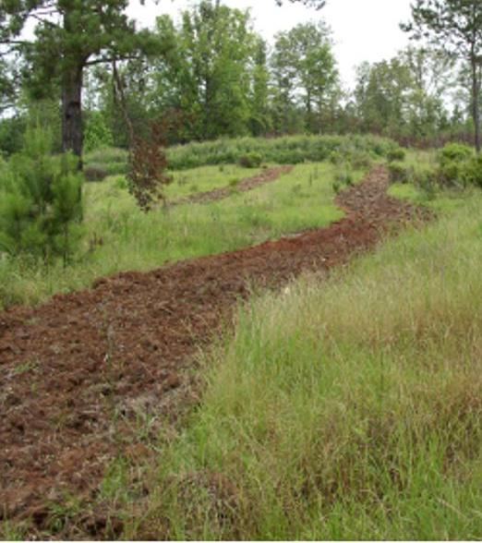
Longleaf Pine
Site preparation is important to remove competition. Burning, herbicide control, and/or scalping the soil will help longleaf establish quicker.
Seedlings planted in the late fall tend to survive and grow better due to reduced competition.
For more information on longleaf establishment: http://www.dfr.state.nc.us/publications/fm39.pdf
{Lecture 3a} Slide: 11/13

Slide 12
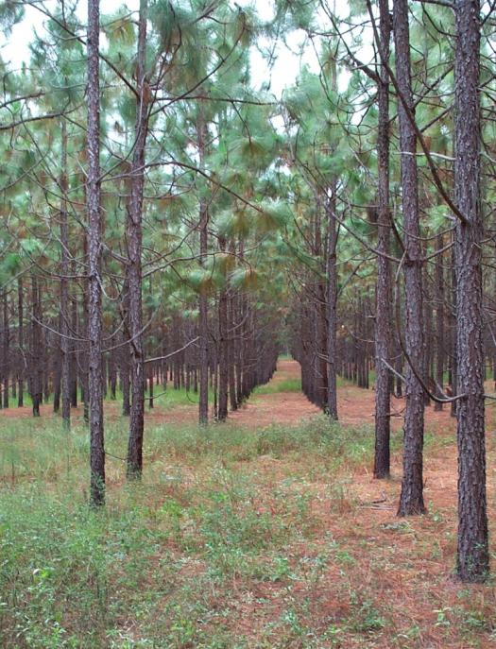
Longleaf Pine
Other considerations
Can begin yielding chip-and-saw and saw timber from 30-45 years
Produces high-quality pine straw for additional income
{Lecture 3a} Slide: 12/13

Slide 13
Summary
Loblolly, slash, and longleaf pines are the three recommended species for pine silvopasture. Each of these species has distinct production and growth characteristics
Species choice should be based on site conditions such as climate and soil type
{Lecture 3a} Slide: 13/13

