Slide 1
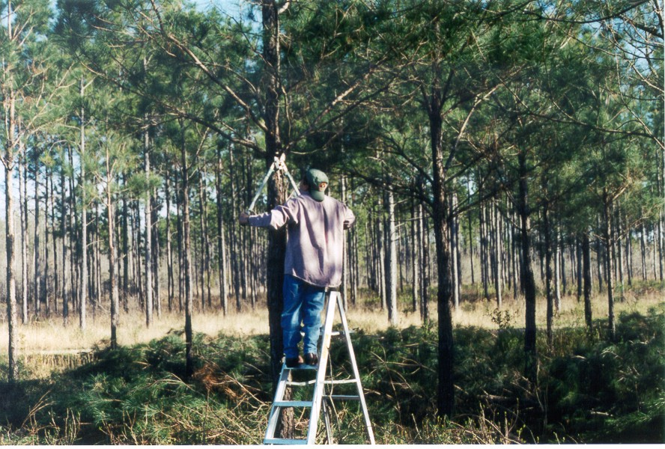
module #4
Pruning
Pine Silvopasture in the Southeast

Slide 2
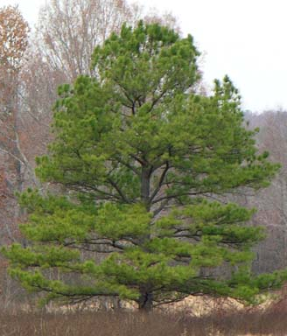
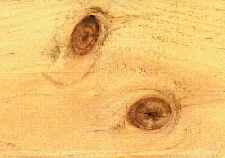
Pruning a Pine Plantation?
Trees grown in lower density silvopasture produce more branches
Growth of branches affects eventual lumber quality by producing knots
After branches die, their bases continue to be surrounded by the growing trunk and knots are formed
Open grown loblolly pine
{Lecture 4a} Slide: 2/12

Slide 3
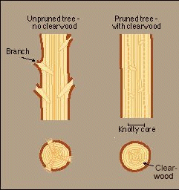
Clearwood vs. Knots
In a silvopasture system, pruning is essential to improve wood quality
Pruning confines the knots produced by branches to a small diameter producing higher quality, knot-free “clearwood” which fetches a higher price
{Lecture 4a} Slide: 3/12

Slide 4
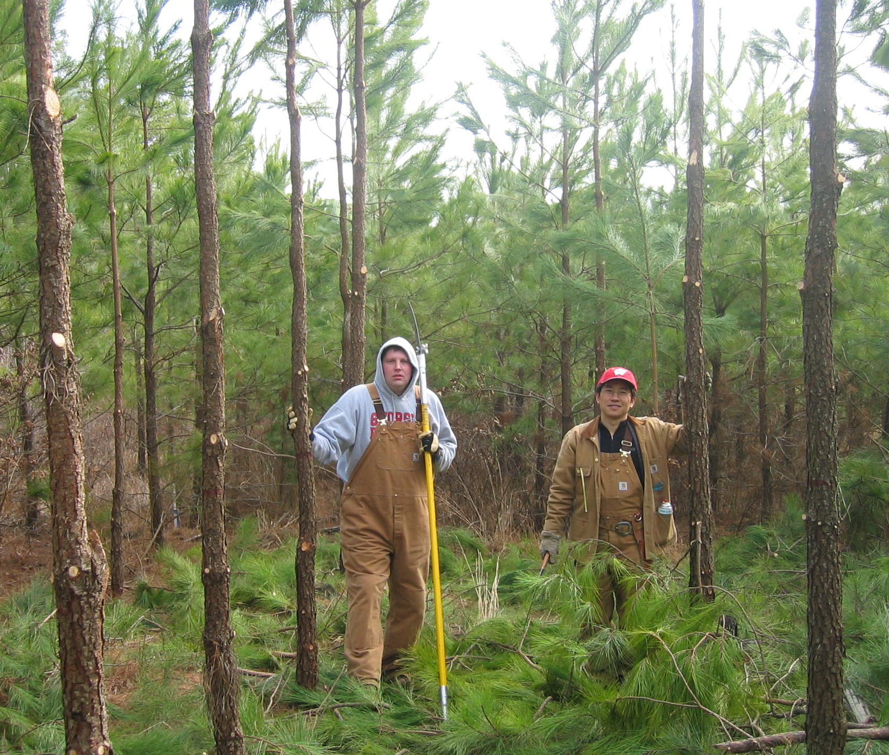
When to Prune
The first pruning should be initiated in the late winter or early spring when the trees have reached 15 to 20 feet tall. By then, the tree should have plenty of branches and root stability to handle pruning.
{Lecture 4a} Slide: 4/12

Slide 5
Pruning Goal
Pruning should remove all of the lower branches but never more than half of the total crown.
1st pruning
{Lecture 4a} Slide: 5/12

Slide 6
Successive Pruning
In successive prunings, the goal is to remove up to ½ of the canopy to eventually create an 18 to 32 foot branch-free trunk
2nd and successive pruning
{Lecture 4a} Slide: 6/12

Slide 7
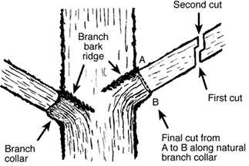
Pruning Technique for Large Branches
Begin pruning cuts on the upper or “branch bark ridge” side of the branch.
For larger branches more than 2 inches in diameter, the first and second cuts (shown above) will prevent the branch from breaking off and damaging the tree by stripping bark from the trunk
{Lecture 4a} Slide: 7/12
Notes:
The first cut is made on the underside of the branch about 15 inches away from the trunk and as far up through the branch as possible before the branch weight binds the saw. The second cut is made downward from the top of the branch about 18 inches from the main trunk to cause the limb to split cleanly between the two cuts without tearing the bark. The remaining stub can then be supported easily with one hand while it is cut from the tree. This final cut should begin on the outside of the branch bark ridge and end just outside of the branch collar swelling on the lower side of the branch.

Slide 8
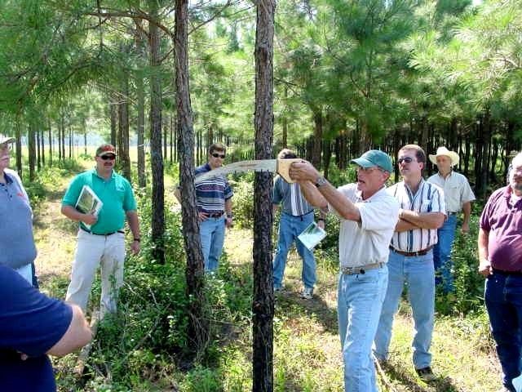
Pruning Equipment
Pruning shears or saws can be used for pruning. Make sure your pruning equipment is sharp to ensure clean cuts!
Avoid pruning with machetes as clean cuts are harder to achieve and tree damage can occur.
Some arborists recommend sterilizing blades with alcohol after pruning each tree to minimize risks of fungal/rust infections
{Lecture 4a} Slide: 8/12

Slide 9
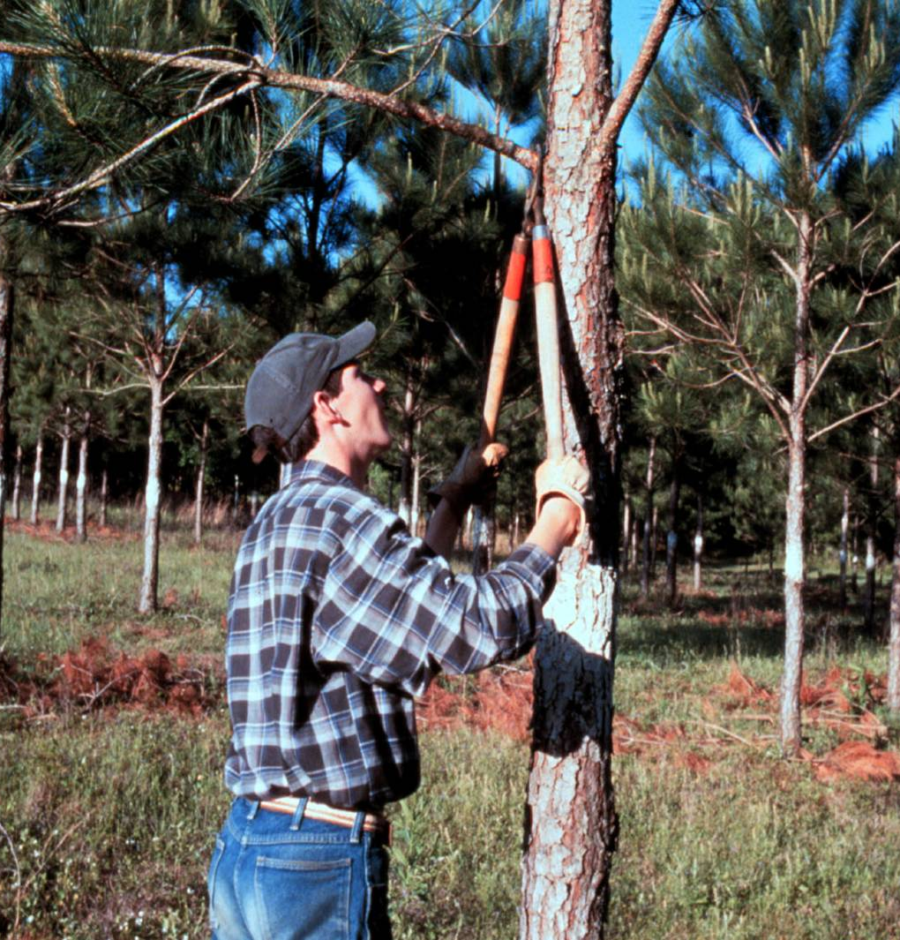
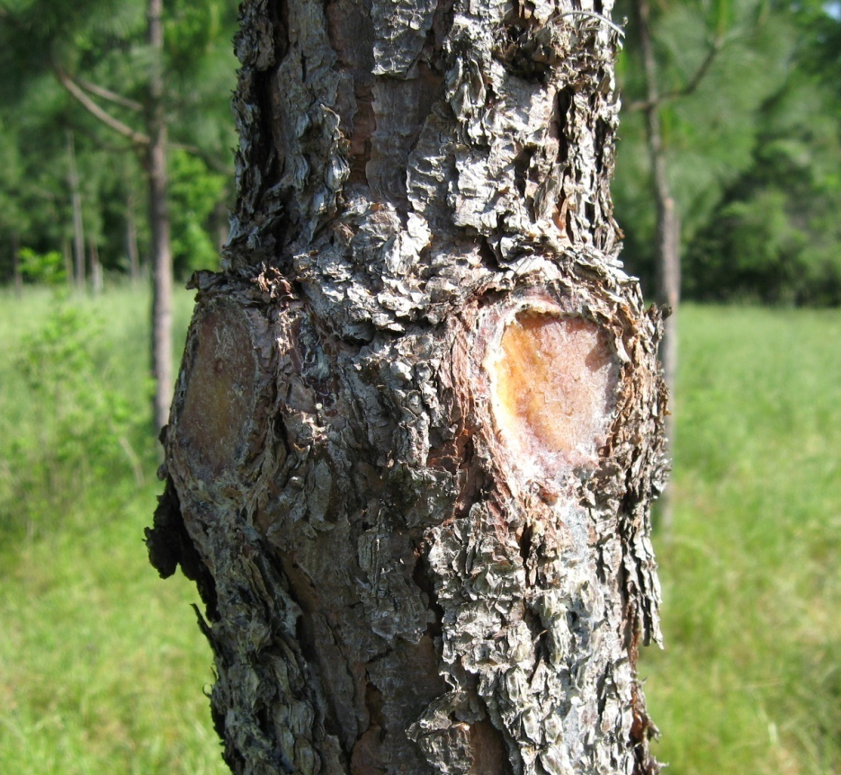
Loppers vs. Saws
While smaller branches can be lopped off with pruning shears…
…pruning saws are recommended to make clean cuts on larger branches
{Lecture 4a} Slide: 9/12

Slide 10
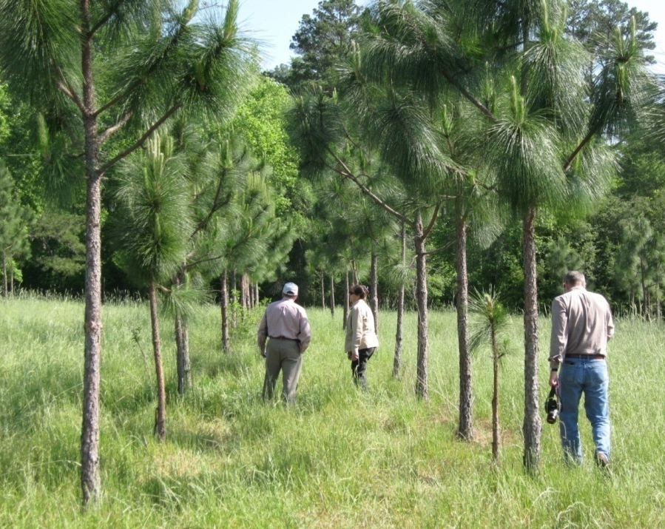
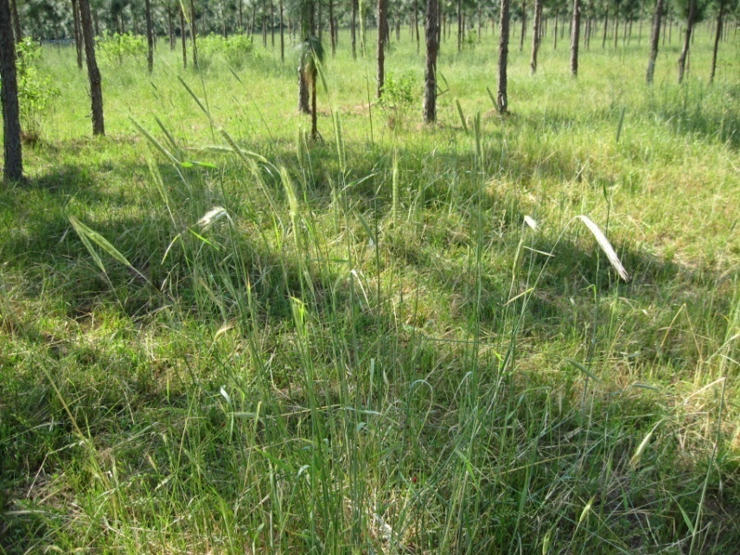
Other Benefits of Pruning
Pruning also allows more sunlight to hit the ground stimulating forage growth and creating an open, aesthetic environment
{Lecture 4a} Slide: 10/12

Slide 11
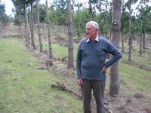
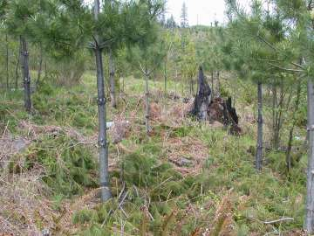
Frequency and Expense
Pruning may occur at 5 year increments depending on tree spacing and growth
Costs have been estimated at around $0.50 to $1.00 per tree depending on the size of the tree
Advantages:
Disadvantages:
{Lecture 4a} Slide: 11/12

Slide 12
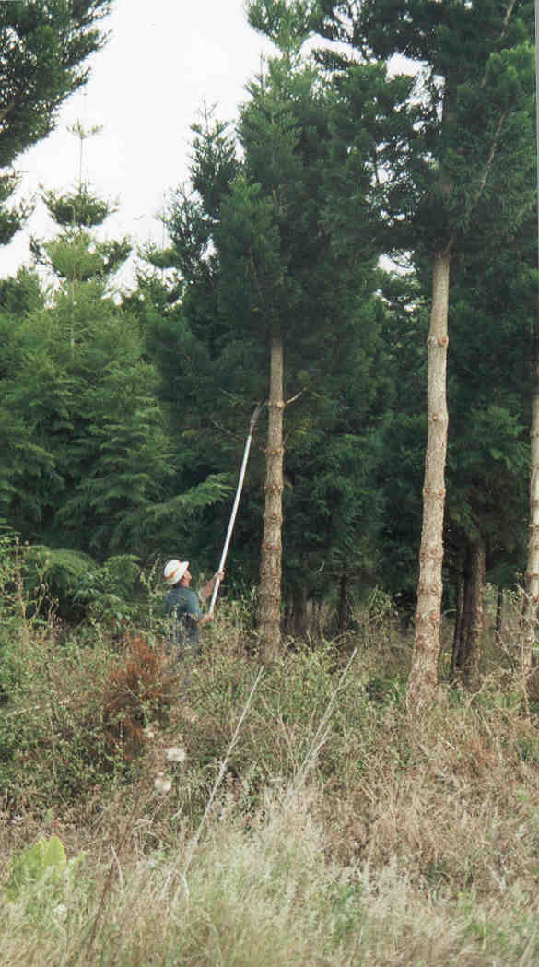
Summary
While not commonly practiced in traditional plantation forestry, proper pruning creates higher-quality timber
If you have additional questions regarding technique or equipment for pruning, you may contact an area arborist or county Cooperative Extension office for tips and suggestions
Advantages:
Disadvantages:
{Lecture 4a} Slide: 12/12

