Slide 1
module #4
Canopy Management and Thinning
Pine Silvopasture in the Southeast

Slide 2
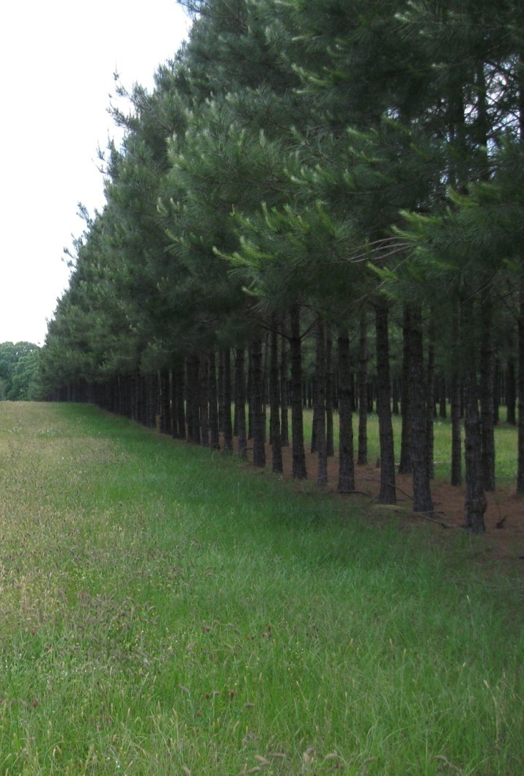
Canopy management
Canopy management is an essential element of maintaining a productive silvopasture
While cool season grasses can thrive at higher canopy densities (more shade), warm season grasses require more sunlight
Even forage in silvopasture “alleys” can be affected by shade from tree rows
{Lecture 4b} Slide: 2/12

Slide 3
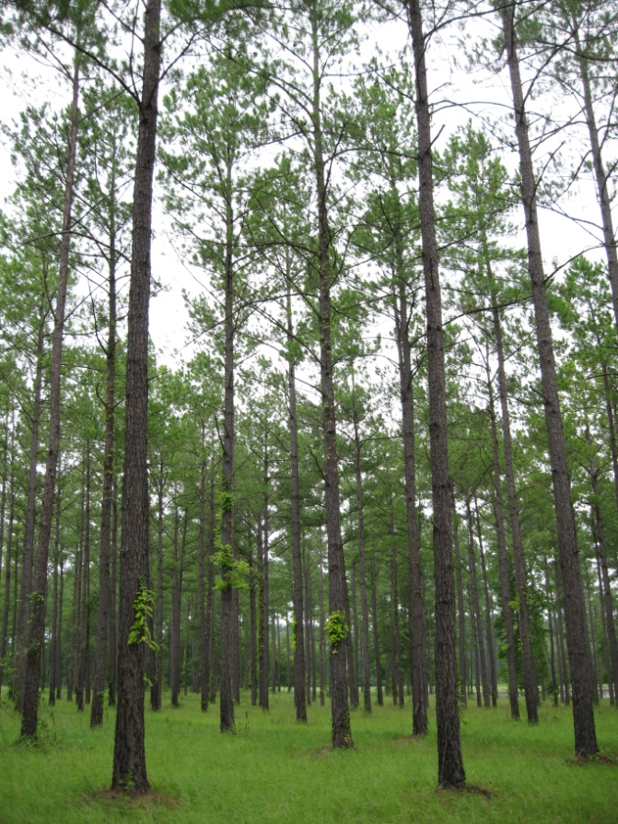
Canopy density
A 25% to 60% canopy is needed to sustain warm to cool season grasses
As the trees planted in a silvopasture system begin to grow, their canopies produce more shade
While pruning trees helps to open up the canopy, thinning is also necessary to maintain forage production and develop higher-quality timber
{Lecture 4b} Slide: 3/12

Slide 4
Measuring Canopy Density
A spherical densiometer is a tool used to measure and calculate canopy density—which is more accurate than “eyeballing”
The instrument has a convex mirror with intersecting lines that form a 24 point grid. Because the mirror is convex, it reflects the canopy overhead.
As there may be some variation between types, follow manufacturers instructions
{Lecture 4b} Slide: 4/12

Slide 5
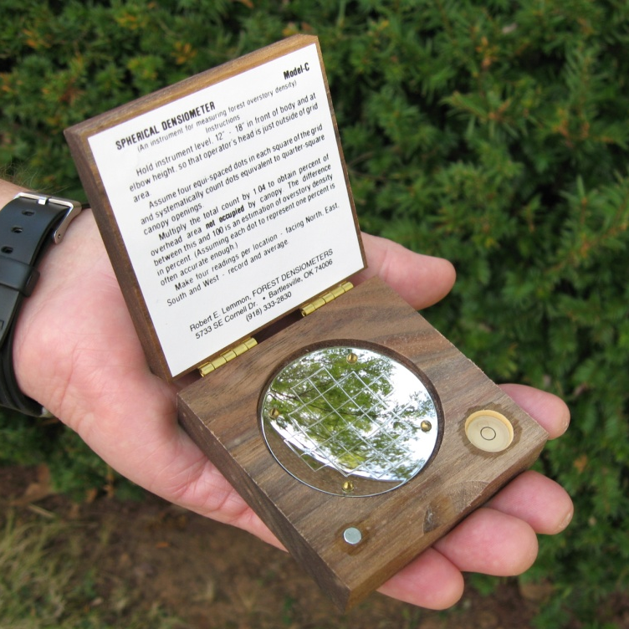
Using a Spherical Densiometer
Hold the densiometer level in front of the body
Count and record the number of grid squares that are more than ¾ filled and divide this number by 24 (the total number of grid squares)
to calculate the percent coverage.
Or…you can multiply the number
of “empty” squares (those less than
¼ filled) by 4.17 and subtract this number from 100 to give you the percentage of canopy cover.
Multiple readings can be averaged to get a canopy density % for the site or the particular plots you are estimating.
{Lecture 4b} Slide: 5/12

Slide 6
When to Thin
Planting arrangement plus tree growth dictates thinning schedule
When canopy closure begins reaching 50% (per densiometer readings) a thinning should be considered
Pines on good sites can be typically be thinned when they reach 12-15 years
{Lecture 4b} Slide: 6/12

Slide 7
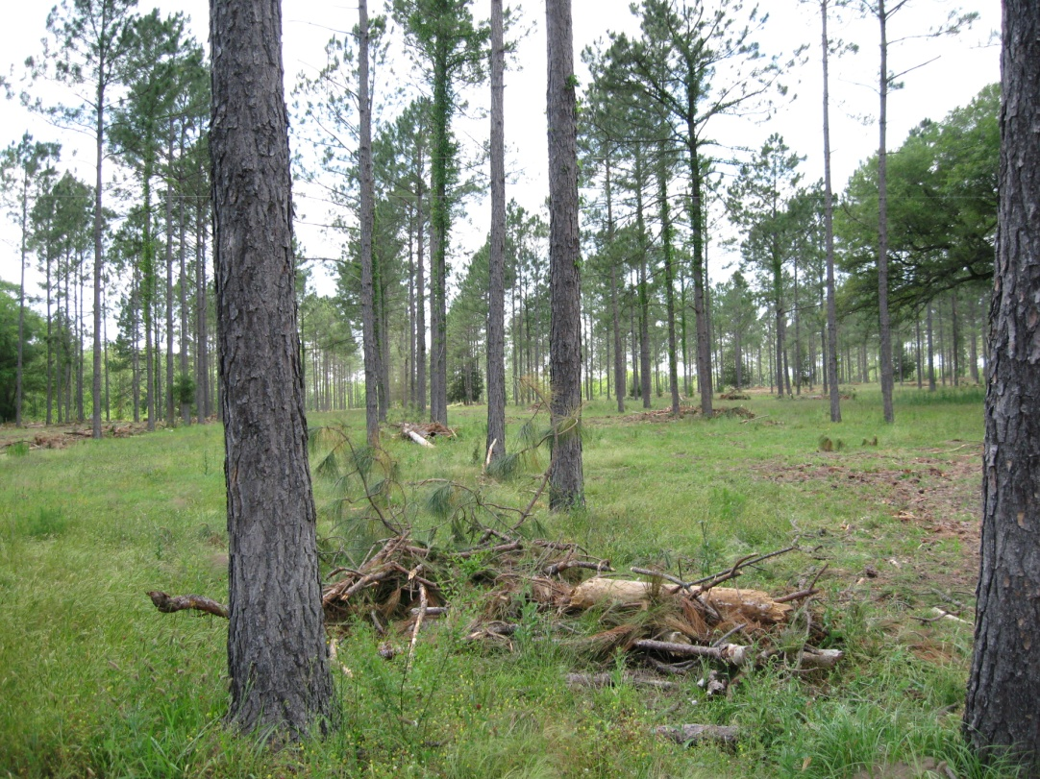
Thinning for Silvopasture
If trees were planted initially at 150-200 trees per acre, only one thinning may be necessary well into the rotation (20 years) to remove poles or saw/veneer quality logs and provide additional space for 10 more years of growth for the high quality saw logs that are left.
A 20 year old stand after final thinning
{Lecture 4b} Slide: 7/12

Slide 8
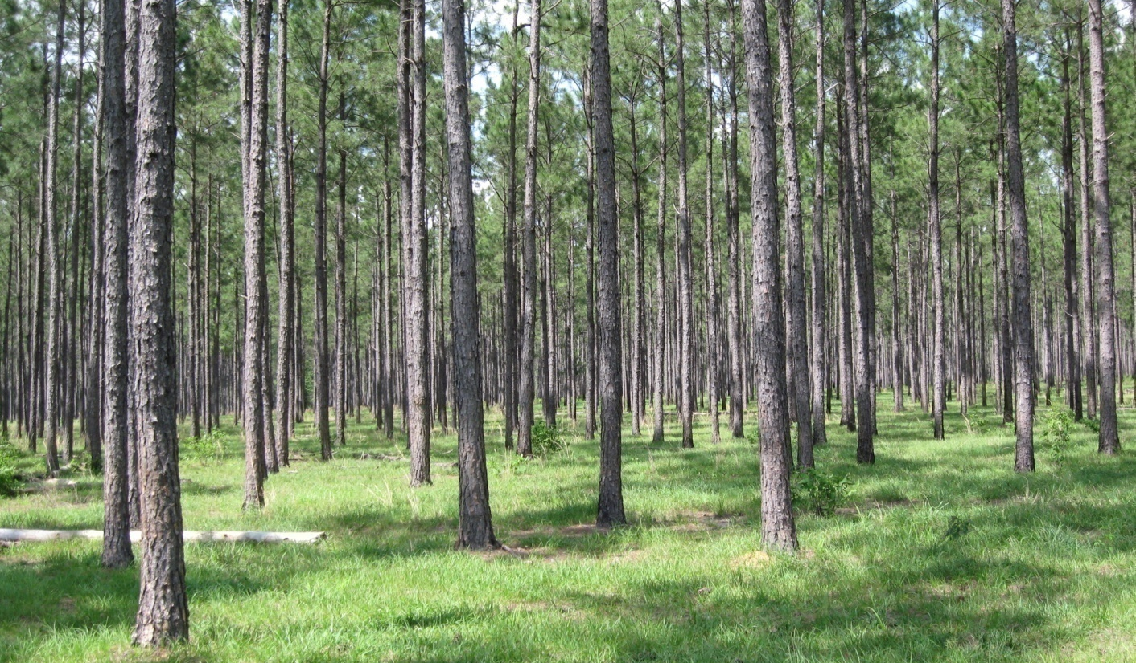
When to Thin
If the stand was more densely planted, thinning may be needed every 5-7 years to remove canopy, improve tree quality, and sustain forage production
{Lecture 4b} Slide: 8/12

Slide 9
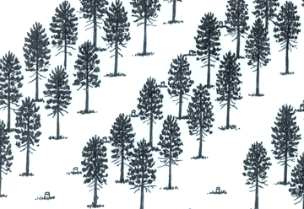
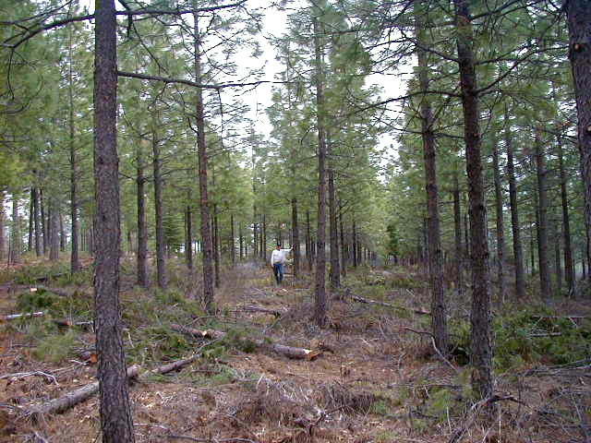
Thinning for Conversion
If you are converting an existing forest or pine plantation to a silvopasture, trees may be thinned to an optimal density for forage production
Trees must be selected and removed to open the canopy to at least 30 to 35 percent to establish forage
{Lecture 4b} Slide: 9/12

Slide 10
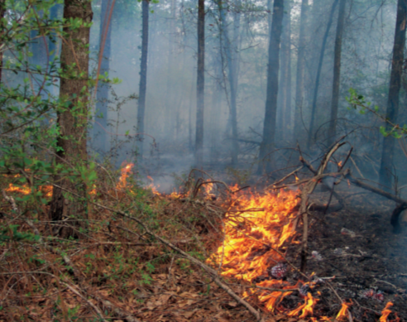
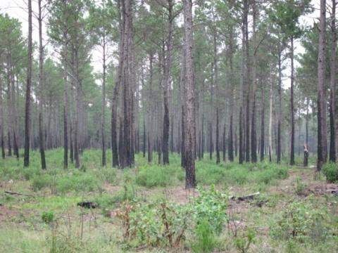
Prescribed burning
After any major pruning or thinning operation, large amounts of slash/debris may build up.
A prescribed burn after a thinning is an efficient way to clean up debris.
Stand after prescribed burn
{Lecture 4b} Slide: 10/12

Slide 11
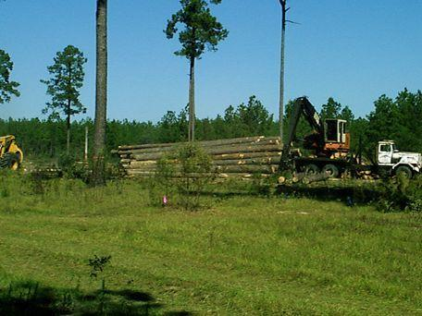
Planning Ahead
Forage alleys eventually serve as access roads for thinning and harvest which reduces the need for additional clearing and road construction for logging operations.
{Lecture 4b} Slide: 11/12

Slide 12
Summary
Canopy management is critical for successful forage growth in a silvopasture
Well-executed pruning and thinning will create high-quality trees for timber as well as high-quality forage for livestock
Having the proper equipment for these tasks is imperative.
If you have questions, you may contact your county or district forestry office or a private forestry consultant for recommendations on pre-commercial thinning and marketing your timber
Advantages:
{Lecture 4b} Slide: 12/12

