Slide 1
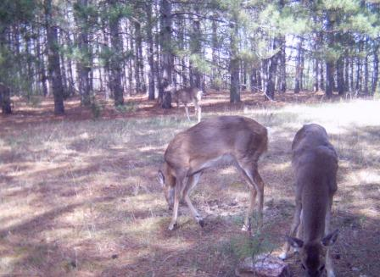
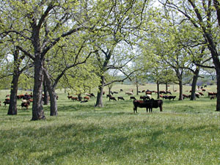
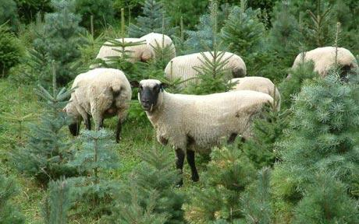
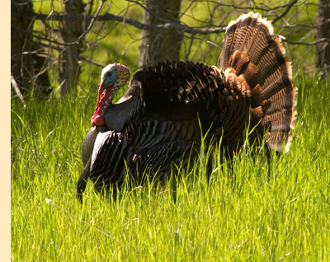
module #7
Other Benefits of Silvopasture
Pine Silvopasture in the Southeast

Slide 2
Additional benefits of silvopasture
A well-designed and managed silvopasture has added value:
Can provide habitat for quail, turkey, and other wildlife
Pine straw can be utilized/sold for landscaping and mulch
Enhances aesthetics and property value
Other tree species besides pines can be established (pecan,
walnut, etc.) to provide alternative crops
Other livestock choices are also suitable for silvopasture
{Lecture 7} Slide: 2/12

Slide 3
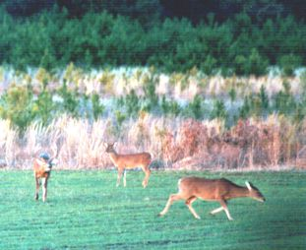
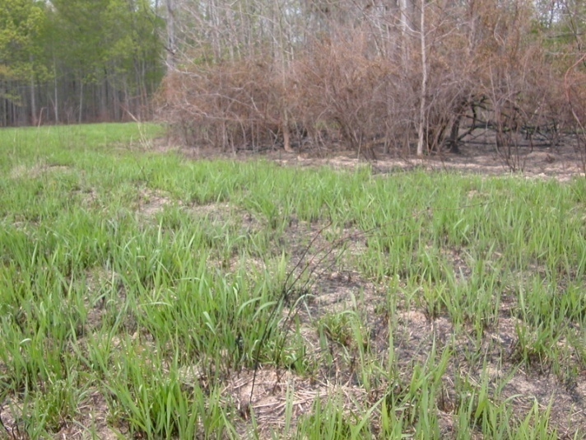
Wildlife habitat enhancement
Different wildlife species have different habitat needs. Some may exist quite well in a silvopasture system that favors trees and livestock while others will need special considerations.
Species preference from the landowner’s perspective will dictate management decisions.
Management can be intensive or passive. Periodic management practices such as thinning and burning naturally improve wildlife habitat.
Switchgrass after late
winter prescribed burn.
{Lecture 7} Slide: 3/12

Slide 4
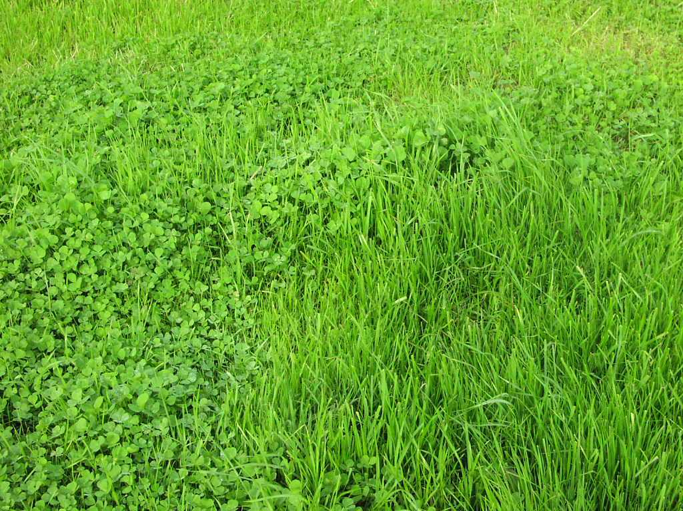
Forage choices for wildlife
Overseeding cool season grasses and legumes can greatly increase food supplies - especially for deer and turkey.
Livestock grazing management and stocking rates must be appropriate to receive wildlife benefits - if livestock are present.
Must know the compatibility
of the plant to soils, climate, moisture, grazing management, and pesticide applications.
Clovers, vetch, cow peas, ryegrass, oats, and wheat are common grass and legume choices.
{Lecture 7} Slide: 4/12

Slide 5
Native grasses enhance habitat
If enhancing wildlife habitat is a goal, choose native grasses for livestock forage instead of exotics such as bermudagrass
or fescue. Native grasses:
Provide excellent cover for game birds
Bunch grasses allow chicks mobility
to feed
Also can provide excellent quality
livestock forage
However…they can also be:
Expensive
Some can be slow to establish
Many require special equipment to plant
Landowner in field of eastern gammagrass.
Turkey in switchgrass.
{Lecture 7} Slide: 5/12

Slide 6
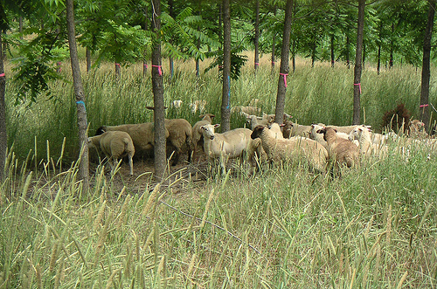
Other silvopasture options
Traditional silvopastures in the southeast primarily involve cattle. However, other “livestock” options include sheep, goats, horses, turkeys, chickens, emu, or game animals such as bison and deer.
{Lecture 7} Slide: 6/12

Slide 7
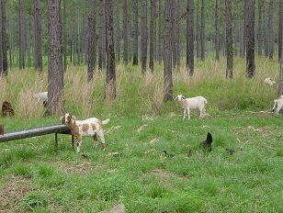
Silvopasture with Goats
Integrating meat-goat production into silvopasture has gained popularity due to an increase in demand by ethnic populations. Goats can be introduced to clean out forests of invasive species and undesirable plants such as brambles and vines.
{Lecture 7} Slide: 7/12

Slide 8
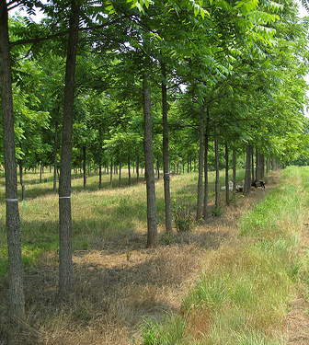
Other tree species for silvopasture
Many different tree species have been integrated successfully into silvopasture.
After the pines, pecan and black walnut are popular species choices.
While rotations for timber are considerably longer with these species (60-80 years for black walnut), nut production can serve as an additional annual crop.
{Lecture 7} Slide: 8/12

Slide 9
Other tree species for silvopasture
Due to relatively short rotations (for a tree crop) some Christmas tree producers have integrated livestock into their plantations.
{Lecture 7} Slide: 9/12

Slide 10
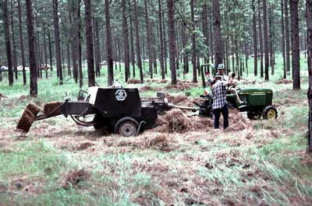
Additional silvopasture products
Pine straw, especially from longleaf pine, is highly valued as a mulch. While more commonly done in traditional pine plantations, straw can be harvested from a silvopasture. However, care must be taken not to overharvest straw which can reduce nutrient cycling in your pine stand.
{Lecture 7} Slide: 10/12

Slide 11
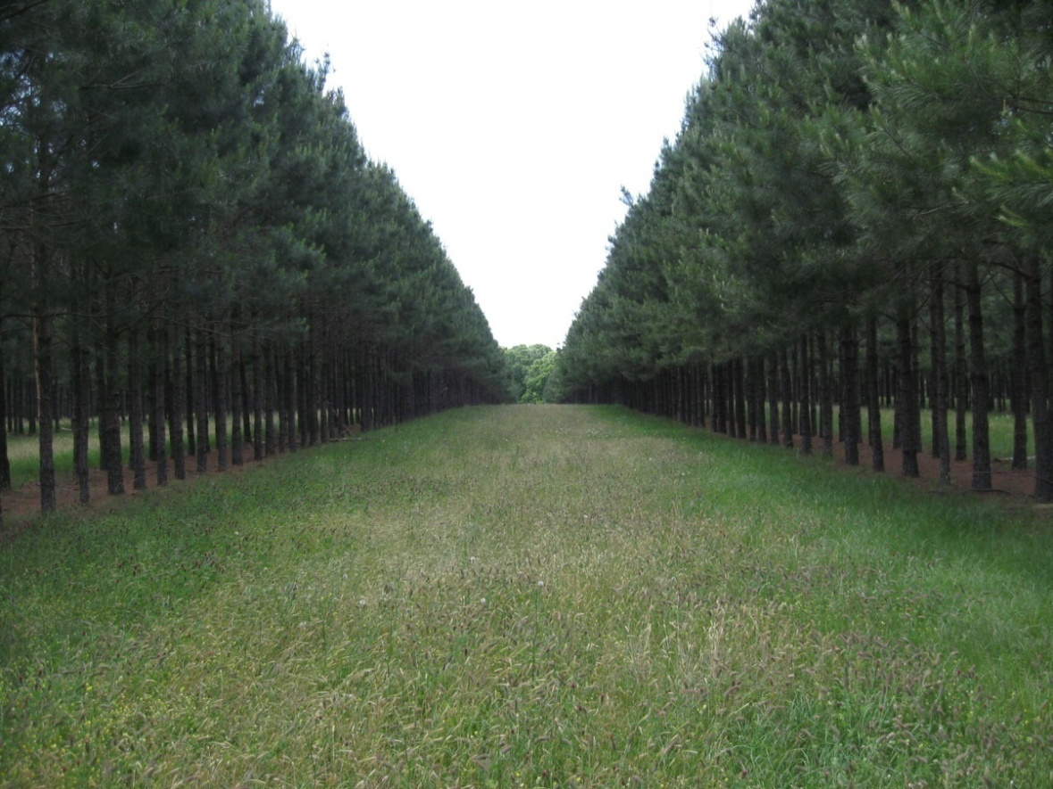
Aesthetics
A well-managed silvopasture can increase property value through its aesthetic quality.
Alleyways between tree rows provide view-sheds that many find more attractive than plantation forests.
Wildlife such as songbirds and deer can also be more readily observed due to lower stand densities.
{Lecture 7} Slide: 11/12

Slide 12
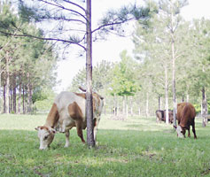
Summary
Native grasses and forbs incorporated into a silvopasture system can provide an increasingly rare cover type in the southeast and increase wildlife which increases aesthetic value of a property in silvopasture.
Ultimately, the quality and diversity of benefits of a silvopasture is up to the landowner’s management goals and decisions.
{Lecture 7} Slide: 12/12

